Slide 1
Chain Restaurant Calorie Posting Mandates, Obesity, and Consumer Welfare
Charles Courtemanche, University of Kentucky and NBER
David Frisvold, University of Iowa and NBER
David Jimenez-Gomez, Universidad de Alicante
Marietou Ouayogode, University of Wisconsin
Michael K. Price, University of Alabama and NBER

Slide 2
Motivation
According to the OECD, healthcare accounts for over 16% of GDP in the US and 9% in the EU
  In the US, obesity alone accounts for 10% of healthcare costs
Behavioral interventions have showed great promise in improving health outcomes
A "nudge" is (Thaler and Sunstein, 2008):
a subtle change in the environment that influences people's behavior in predictable ways, without restricting their choices or significantly altering their economic incentives
We analyze a calorie labels nudge that incorporates calorie information on restaurant menus

Slide 3
Motivating Problem: Why Do Nudges Work
Shift focus from evaluating whether a given policy works to understanding why a policy works
  Allow academics to derive welfare effects of different policies and refine models of choice
  Allow policymakers to identify “new” policy instruments or improve effectiveness of existing policies
Open question: What drives changes in behavior?

Slide 4
Calorie Labels Matter
Improve consumer welfare
  Some systematically underestimate calories consumed at restaurants despite availability of “hidden” information
  Improved salience could address information imperfection. Healthier food choices, less obesity, and greater utility
But also in a way that hurts consumer welfare
  Nudges may influence choice by imposing psychic cost (moral cost, shadow tax, guilt) (Glaeser, 2006; Levitt and List, 2007; Andreoni and Rao, 2011; Della Vigna et al., 2012)
  Similarly, calorie labels may trigger guilt or “shadow tax” on high calorie items
    People consume fewer calories and make healthier choices. But may be worse off than if did not observe label
This is our main point of departure from prior studies examining the effects of calorie labeling on food choices or weight

Slide 5
What We Do
Explore these issues in the context of mandates for chain restaurants to post calorie counts on menus/menu boards
  Salience of the information “nudges” individuals to make healthier choices
Calorie posting provision in the Affordable Care Act (ACA) took effect in 2018
  We study local/state mandates that took effect prior to the ACA
Our main objectives:
  Develop theoretical model of calorie labels to guide empirical analysis and interpretation of results
  Examine patterns of impacts on obesity and consumer well-being in an attempt to begin to understand not just whether calorie labeling nudges “work”, but also why

Slide 6
Overview of empirical results
Calorie labels reduce calorie consumption for everyone
Calorie labels have heterogeneous welfare effects:
  Welfare is reduced for those with healthy BMI
  But not for those who are overweight/obese

Slide 7
Theoretical model

Slide 8


A Theory of Calories and Meal Choices
Individuals select a meal x given a menu and also choose outside calories in a given choice environment e
  Meal calories
  Total calories
Environment e = 0 means no nudge, and e = 1 means that the nudge (calorie labels) is active
The individual has beliefs about the calories of the meal, and these depend on the environment

Slide 9
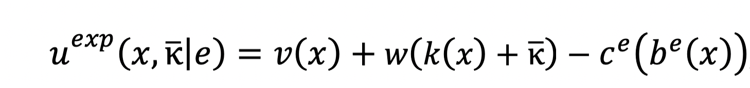
A Theory of Calories and Meal Choices
Experienced utility:
Decision utility:
meal utility
optimal weight function
moral cost
non-informational internality

Slide 10
A Theory of Calories and Meal Choices
Assumptions:
The marginal non-informational internality is smaller with the nudge
Marginal moral costs are higher with the nudge
Beliefs about calories become more accurate with the nudge
Without the nudge, individuals do not underconsume and do not overestimate calories
Proposition 1. Calorie labels (weakly) reduce the amount of calories consumed at the restaurant, as well as the total amount of calories consumed.

Slide 11
Empirical result I:
Nudge decreases calories consumed

Slide 12
Background on Calorie Labels
The 2010 Affordable Care Act (ACA) introduced a national mandate requiring chain restaurants and retail food establishments with 20 or more locations to post calories on menus and menu boards
  The start date of this mandate was repeatedly delayed but ultimately implemented in 2018
  Some local/state jurisdictions passed mandates prior to the ACA
  Policymakers in many jurisdictions where mandates had passed shortly before the ACA never implemented them because of uncertainty about the final rules of the ACA mandate and the potential costs to restaurants to adopt certain menu labels only to change them when the ACA mandate took effect

Slide 13
Empirical Strategy:
Exploit Geographic Heterogeneity
Differences in strength of enforcement across locations: some passively enforce
Worked with a health policy expert to distinguish laws that were implemented, enforced, and never repealed from those that were either repealed or never enforced
  Expert supplemented exhaustive review of legal statutes and media articles regarding state and local health departments and revealed substantial variation in the level/duration of enforcement of the implemented laws

Slide 14
Empirical Strategy: Local Mandates
Localities | Date of Implementation | # of Establishments
Passed and Actively Enforced
New York City, NY | April 2008 | ≥15
Westchester County, NY (NYC MSA) | June 2009 | ≥15
Philadelphia City/County, PA | January 2010 | ≥15
Montgomery County, MD (DC MSA) | July 2010 | ≥20
Schenectady County, NY (Albany MSA) | October 2010 | ≥15
Suffolk County, NY (NYC MSA) | November 2010 | ≥15
Passed but Passively Enforced
Seattle (King County, WA) | January 2009 | ≥15
Albany County, NY | April 2010 | ≥15
State of Vermont | January 2011 | ≥20

Slide 15
Identification Strategy: BRFSS Data
Use data from Behavioral Risk Factor Surveillance System (BRFSS) to examine impact of local mandates
  Changes in BMI (proxy for caloric intake)
  Changes in life-satisfaction (proxy for consumer welfare)
Differences in outcomes after implementation across locations with mandate (treatment group) and nearby counties (control group)
Heterogeneity across areas depending on stringency of enforcement

Slide 16
Sample Frame: BRFSS Data
Telephone survey focusing on health and health behaviors
  Conducted by state health departments and CDC
  Repeated cross sections of randomly sampled adults
County identifiers available for 1994-2012
  Ending sample in 2012 avoids confounding from major chains voluntarily posting calories
Question about life satisfaction available for 2005-2010
594,364 observations in total

Slide 17
Expand Data: Role of Information Content
Are effects different in areas with lax enforcement?
  Likelihood that restaurants report posting calories
  Likelihood that consumers report noticing calories on menus
We constructed a novel dataset by
  Phone surveys of all chain restaurants in sample areas to check if they are currently posting calorie counts on menus (called 15,099 restaurants)
  Survey of 5,228 individuals living in sample areas (Survey 1) asking if they have noticed calorie counts on menus when eating out

Slide 18
BMI Effects: Regression Analysis
We also consider variant that allows effects to differ across counties that actively and passively enforce local mandates:
  the law was implemented but is not currently actively enforced
  the law was passed but not yet implemented

Slide 19
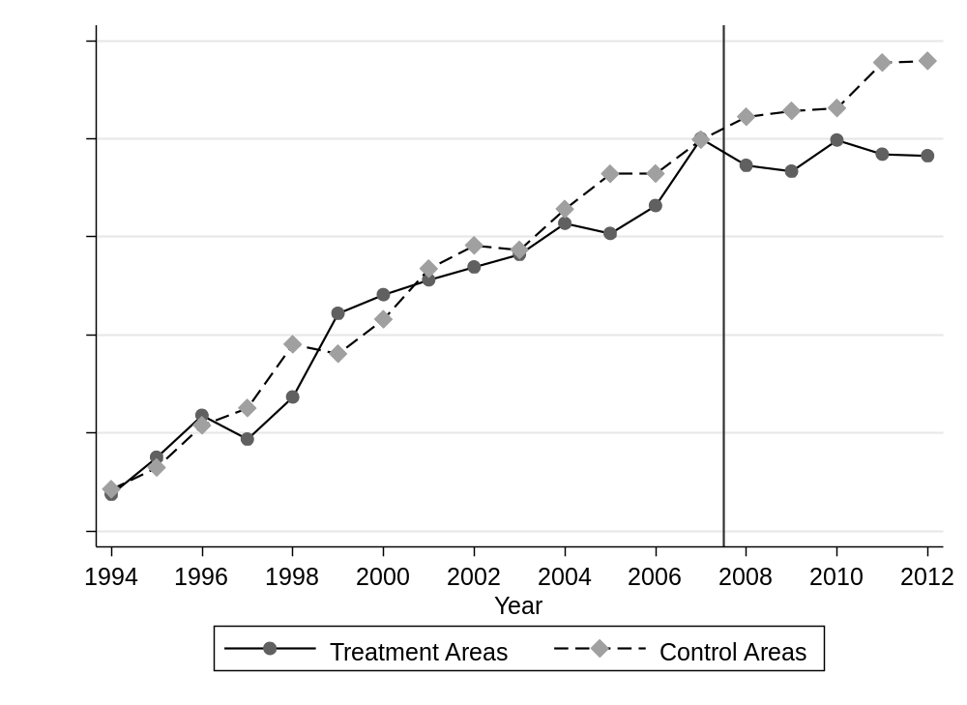
BMI Trends

Slide 20
BMI Effects: Regression Analysis
 | (1) | (2)
Law Implemented | -0.174** (0.081) | -0.191* (0.099)
Law Implemented but No Longer Actively Enforced |  | 0.126 (0.121)
Law Passed but Not Yet Implemented |  | 0.001 (0.099)
Sample size | 594,364 | 594,364
Mean of Outcome | 26.711 | 26.711

Slide 21
BMI Effects: Interpreting the Magnitude
Implementation of calorie posting laws reduce BMI by 0.19
  Decrease of approximately 0.7 Kg
  Decrease of 0.7%
Roughly due to a decrease of 105 calories consumed per week
  Average household eats 5 meals per week away from home (Saksena et al., 2018)
  40% of restaurants would be required to post calories (chains with ≥ 20 locations)
  => 2 meals per week affected by calorie posting requirements
  => BMI results due to a decrease of 53 calories consumed per meal at chain restaurants

Slide 22
Results are robust
Using event study methods
Placebo tests with pre-dated treatments to examine pre-trends
Recent DD methods (Borusyak, Jaravel & Spiess, 2024)
Controlling for avg. calories consumed outside the home, avg. food prices
Controlling for smoking, exercise
Vary control variables or drop all control variables
Drop county trends
Shorter pre-treatment periods
Exclude adjacent counties
Cluster standard errors by state or treatment area rather than county
Control group based on population density rather than proximity
Synthetic control group

Slide 23
BMI Effects: Ruling out Compensating Behavior
 | P(Smoker) | Drinks per Month | P(Any Exercise) | Minutes per Week Moderate Exercise | Minutes per Week Vigorous Exercise
Law Implemented | 0.001 (0.007) | -0.167 (0.379) | 0.001 (0.012) | -3.283 (3.419) | 0.828 (1.946)
Law Implemented but No Longer Actively Enforced | 0.016** (0.006) | 0.064 (0.381) | 0.008 (0.010) | 2.083 (2.915) | 1.734 (1.475)
Law Passed but Not Yet Implemented | -0.007 (0.005) | -1.037* (0.576) | 0.012 (0.009) | -0.717 (2.307) | 0.965 (1.749)
Sample Size | 591,432 | 526,857 | 545,840 | 194,705 | 194,705
Mean of Outcome | 0.192 | 10.979 | 0.762 | 49.600 | 30.093
More robustness checks

Slide 24
BMI Effects: Comparison to Field Experiments
Our estimates (BMI↓ by 0.17) are lower than predicted from field experiments
  Wisdom et al. (2010): ↓ of 99 calories in a meal => BMI ↓ by 0.75
  VanEpps et al. (2016): ↓ of 60 calories => BMI ↓ by 0.47
  Cawley et al. (2018): ↓ of 45 calories => BMI ↓ by 0.35
Individuals can avoid calorie labels by choosing restaurants that are not required to post calories (or not eating at a restaurant)
If calorie labels result in guilt or psychic costs, sorting is more likely
Would attenuate results. Relates to literature on scalability (Al-Ubaydli et al., 2017a,b)
Dynamic effects: Future research avenue

Slide 25
Empirical result II:
Heterogeneous effect on welfare

Slide 26
Population Heterogeneity and Predictions
Heterogeneity in the population has been shown crucial for behavioral welfare economics (Allcott and Taubinsky, 2015; Taubinsky and Rees-Jones, 2018; Allcott and Kessler, 2019)
Suppose that the population can be divided in two groups, A and B
  individuals in A have no informational problems or non-informational internalities
  individuals in B are misinformed about calories and/or have positive marginal non-informational internalities

Slide 27
Population Heterogeneity and Predictions
Proposition 2.
The following predictions hold true for the introduction of calorie labels:
Those in A will have a welfare loss from the nudge
The welfare effect in B is ambiguous and depends on the relative size of:
  the gains from information
  the reduction in the non-informational internality
  the moral cost associated with the nudge

Slide 28
Empirical Strategy: Moral Costs
Step 1. Experimental evidence on the existence of moral costs (Survey 2)
Step 2. Examine individual heterogeneity in the impact of local calorie labeling laws

Slide 29
Step 1. Evidence on Moral Costs
Conducted Survey 2: survey of 2000 adults in Sept/Oct 2022 (Qualtrics)
  Randomize whether individuals see the number of calories
Do people feel guiltier when ordering high calorie items if they know the number of calories?
  "On a scale of 1 to 7, where 1 is "not at all guilty" and 7 is "very guilty," rate how guilty you would feel if you ordered the following menu items
Do people think it is socially appropriate to order high calorie items?
  "Consider an individual who is taking an after lunch coffee break at a Starbucks Coffee Shop. The menu below gives a description of six different drinks of S size that the individual could order. For each of these drinks, please indicate whether you believe that ordering that option is very socially inappropriate, somewhat socially inappropriate, somewhat socially appropriate, very socially appropriate. To indicate your response, please place a checkmark in the corresponding box."

Slide 30
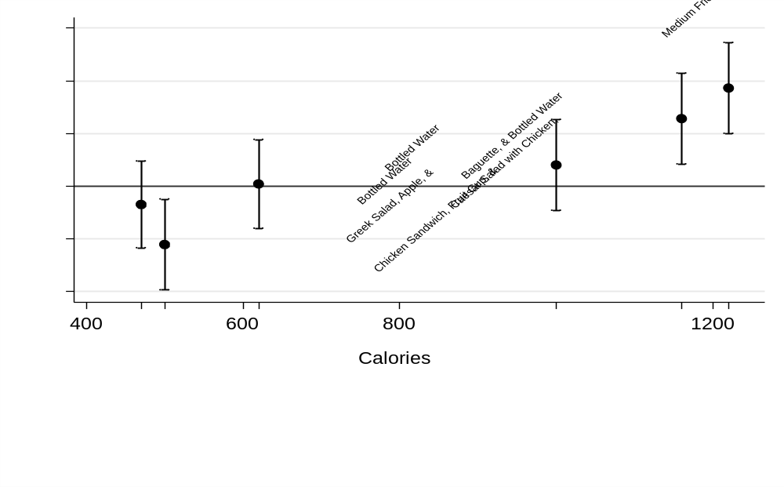
Step 1. Survey results on guilt and calories
Guilt increases when observing calories, for high calorie items

Slide 31
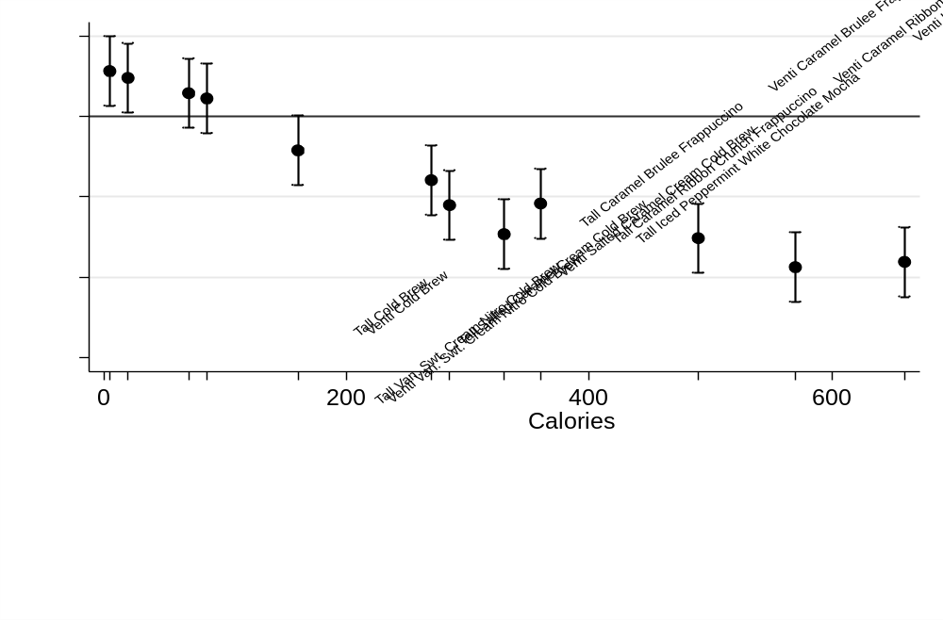
Step 1. Survey results on social appropriateness
It is less socially appropriate to order high calorie items, when observing calories

Slide 32
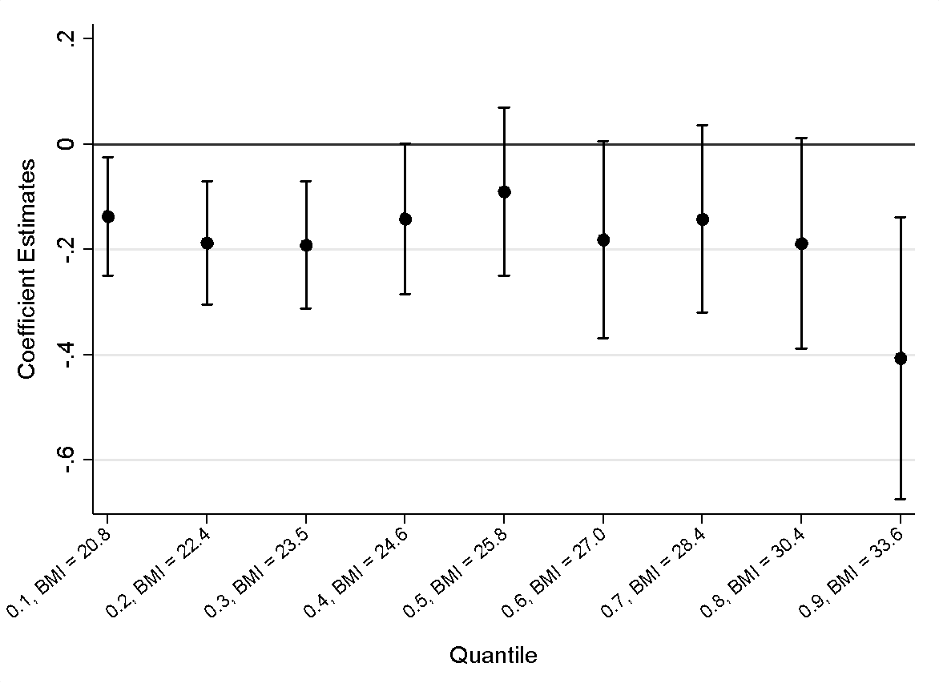
Step 2. Heterogeneous Effects on BMI
Examine changes in calorie consumption (BMI): who loses weight?
  Information channel: weight loss concentrated amongst those subgroups who systematically underestimate calories (B-types)
  Moral costs channel: all consumer types lose weight
Quantile regression of nudge on BMI
Ruling out alternative explanations

Slide 33
Step 2. Effect of nudge on life satisfaction
Life satisfaction has been shown to be a good proxy for welfare/utility (Kaiser and Oswald, 2022). BRFSS data contains life satisfaction questions from subset of years that span earliest adoptions
Model predicts reductions in satisfaction for A-types and ambiguous effects for B-types if moral costs are important
 | All | Healthy Weight | Overweight or Obese
Law Implemented | -0.036 | -0.105*** | 0.009
 | (0.020) | (0.037) | (0.022)
Observations | 82,203 | 30,834 | 50,121
Mean of Outcome | 0.000 | 0.074 | -0.042
Event study results
Other robustness checks

Slide 34
Discussion
&
Conclusion

Slide 35
Putting It All Together: A Quick Summary
Empirically we find:
  A types (healthy weight): lower BMI, lower life satisfaction
  B types (overweight/obese): lower BMI, no change in life satisfaction
This is what the theoretical model predicts (Propositions 1 and 2)
Effects on BMI and life satisfaction suggest multiple channels impacted by calorie labels
  Moral costs from greater awareness of caloric content – lower life satisfaction
  Correcting imperfect information – impacts on BMI among those with greater “bias” in beliefs
Welfare effects of mandate are thus uncertain…but suggests that “nudge” is not entirely benign: there are trade offs to consider

Slide 36
Literature review
Behavioral interventions to achieve policy goals
  information on fuel efficiency (Allcott and Knittel, 2019), energy costs and savings (Allcott and Taubinsky, 2015; Davis and Metcalf, 2016; Allcott and Sweeney, 2017), benefits of school choice or post-secondary education (Hastings and Weinstein, 2008; Jensen, 2010; Barr and Turner, 2018), female labor force participation rates (Bursztyn et al., 2020), electricity and water conservation (Allcott, 2011; Costa and Kahn, 2013; Ferraro and Price, 2013; Allcott and Rogers, 2014), tax compliance (Fellner et al., 2013; Dwenger et al., 2016; Hallsworth et al., 2017), traffic violations (Chen et al., 2017), and the use of credit cards (Seira et al., 2017), the design of “sin” taxes (Gruber and Koszegi, 2004; Taubinsky and Rees-Jones, 2018; Allcott et al., 2019) and efforts to “nudge” the repayment of credit card debt (Bursztyn et al., 2019)
  most closely related to studies by Bollinger et al. (2011), Deb and Vargas (2016), and Restrepo (2017) exploring the impact of calorie labels on calories purchased or BMI
Subjective well-being to estimate the effects of policies and economic shocks
  airport noise (Van Praag and Baarsma, 2005), flood disasters (Luechinger and Raschky, 2009), traffic congestion (Anderson et al., 2016), and air pollution (Luechinger, 2009; Levinson, 2012)
Behavioral welfare economics
  importance of heterogeneity in the population (DellaVigna et al., 2012; Allcott and Taubinsky, 2015; DellaVigna et al., 2017; Taubinsky and Rees-Jones, 2018; Allcott and Kessler, 2019; Allcott et al., 2022)

Slide 37
Discussion
Overall pattern of results is consistent with a model featuring both correction of imperfect information and moral costs
The negative effect on life satisfaction should be treated as only a preliminary step toward understanding welfare effects
  Possible reduction in externalities from medical costs not accounted for
  People might underestimate long-run health benefits
  Producer surplus not considered
Role for “precision nudging” identifying ex-ante those who would benefit from the nudge, then taylor the nudge to them

Slide 38
Conclusion
A calorie labels nudge reduces BMI, but less than previously found
The nudge also has differential effects on welfare: reduction for those with normal BMI, no change for those with highest BMI
Crucial to analyze not only the direct effect of policies, but also their welfare effects across the population (heterogeneous effects)
  Potential to increase welfare through “precision nudging”
The paper shows the importance of combining theory and empirics

Slide 39
Appendix
Charles Courtemanche, University of Kentucky and NBER
David Frisvold, University of Iowa and NBER
David Jimenez-Gomez, Universidad de Alicante
Marietou Ouayogode, University of Wisconsin
Michael K. Price, University of Alabama and NBER

Slide 40
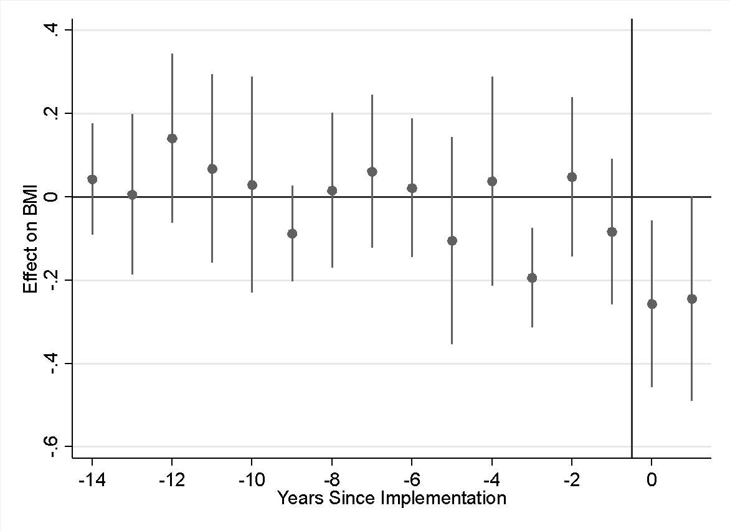
BMI Estimates: Event Study Results
Back to slide

Slide 41
BMI Effects: Artifact or Information
Likelihood that restaurants report posting calories
Likelihood consumers in area report noticing calories
 | Actively Enforced Local Laws | Weakly Enforced Local Laws | No Local Laws
Spring 2017 | 0.829 | 0.734 | 0.579
N | 2305 | 1199 | 11595
 | Actively Enforced Local Laws | Weakly Enforced Local Laws | No Local Laws
Dec 2014 | 0.489 | 0.411 | 0.360
N | 581 | 365 | 1556
Back to slide

Slide 42
Ruling out alternative interpretations
Calorie posting requirements do not change weight status
  No endogenous sample selection when examining heterogeneity
No differential exposure to calorie labels based on weight status
  Calorie labels noticed by:
    44.2% of individuals with healthy weight
    42.6% of individuals with overweight
    41.2% of individuals with obesity
Back to slide

Slide 43
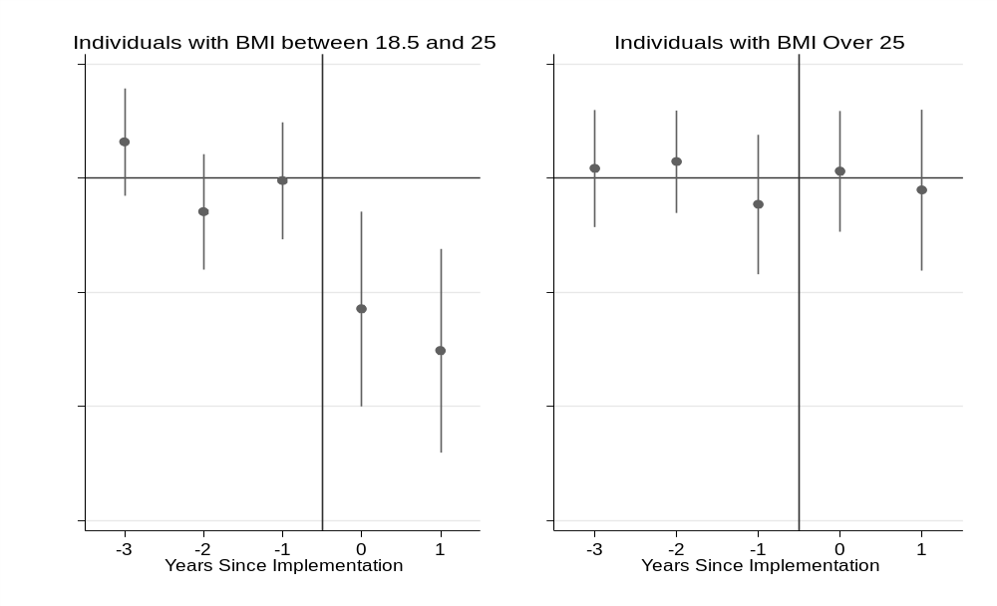
Step 2. Effect of nudge on life satisfaction
Back to
slide

Slide 44
Life Satisfaction
 | P(Very Dissatisfied) | P(Dissatisfied) | P(Satisfied) | P(Very Satisfied)
Law Implemented | 0.0021** (0.0010) | 0.0060** (0.0030) | 0.0179** (0.0091) | -0.0260** (0.0131)
Law Passed but Not Yet Implemented | 0.0011 (0.0012) | 0.0033 (0.0035) | 0.0097 (0.0104) | -0.0141 (0.0151)
Mean of Outcome | 0.0121 | 0.0496 | 0.5256 | 0.4127
n=82,203
Back to slide

Slide 45
Heterogeneous Effects…Part I
 | P(Very Dissatisfied) | P(Dissatisfied) | P(Satisfied) | P(Very Satisfied)
Healthy Weight Subsample (n=30,834)
Law Implemented | 0.0039*** (0.0012) | 0.0138*** (0.0046) | 0.0495*** (0.0172) | -0.0672*** (0.0228)
Law Passed but Not Yet Implemented | 0.0014 (0.0010) | 0.0048 (0.0039) | 0.0171 (0.0137) | -0.0233 (0.0186)
Mean of Outcome | 0.0091 | 0.0442 | 0.4756 | 0.4710
Overweight or Obese Subsample (n=50,121)
Law Implemented | 0.0001 (0.0015) | 0.0002 (0.0039) | 0.0005 (0.0104) | -0.0007 (0.0157)
Law Passed but Not Yet Implemented | 0.0008 (0.0016) | 0.0021 (0.0042) | 0.0056 (0.0114) | -0.0084 (0.0172)
Mean of Outcome | 0.0145 | 0.0538 | 0.5331 | 0.3986
Back to slide

Slide 46
Heterogeneous Effects…Part II
 | Quantile
 | Healthy Weight |  |  |  | Overweight |  |  | Obese
 | 0.1 | 0.2 | 0.3 | 0.4 | 0.5 | 0.6 | 0.7 | 0.8 | 0.9
Law Implemented | -0.13 (0.057) | -0.188 (0.060) | -0.192 (0.062) | -0.142 (0.073) | -0.090 (0.082) | -0.181 (0.096) | -0.142 (0.091) | -0.188 (0.102) | -0.407 (0.137)
BMI at Quantile | 20.80 | 22.35 | 23.54 | 24.61 | 25.80 | 27.02 | 28.40 | 30.36 | 33.55
Back to slide

