Slide 1
Stereotypes and Belief Updating
Katherine Coffman, Harvard Business School
Manuela Collis, University of Toronto
Leena Kulkarni, Array
September 2023

Slide 2
Motivation
Beliefs of our own talents matter:
For willingness to compete (NV 2007)
For test-taking (Baldiga 2014)
For speaking up (Coffman 2014)
For educational decisions (Pan 2018, Buser et al 2014)
For career choices (Reuben et al 2014)
For financial decision-making (Barber and Odean 2001)
Lots of evidence for a gender gap in self-confidence, mostly in male-typed domains

Slide 3
Motivation
Two important open questions:
Why do these gaps persist?
How do we close them?
Answers to both rely on understanding how people update their beliefs about themselves in response to new information

Slide 4
Motivation
Recent literature on how individuals update beliefs about themselves
(Mobius et al 2022, Barron 2016, Buser et al 2016, Coutts 2018, Gotthard-Real 2017, Ertac 2011, Eil and Rao 2011, Schwardmann and van der Weele 2018, Zimmermann 2020)
Common – but not universal - findings:
Conservatism: individuals don’t respond “enough” to information
Asymmetry: individuals respond more to “good news” than bad
Less known about gender differences. Results have been mixed.
Mobius et al (2022) and Coutts (2018) find greater female conservatism than male conservatism
Ertac (2011) finds mixed results on gender differences in asymmetry. No differences in asymmetry in Mobius et al (2022) and Coutts (2018).

Slide 5
Our Goal
Explore gender differences in how individuals update their beliefs about themselves in response to highly informative feedback.
Attempt to better understand the persistence of gender gaps in self-confidence
Focus on the role of stereotypes in shaping responses to information

Slide 6
Our Goal
Explore gender differences in how individuals update their beliefs about themselves in response to highly informative feedback.
Attempt to better understand the persistence of gender gaps in self-confidence
Focus on the role of stereotypes in shaping responses to information
The idea: gender gaps in self-confidence persist because we interpret new evidence through the lens of stereotypes

Slide 7
Experimental Design
Participants complete 3 rounds of the experiment, with a different randomly-drawn domain in each round

Slide 8
Experimental Design
Understanding the role of stereotypes
Vary the gender-type of the domain (male-typed, female-typed)
Maintain parallelism across other aspects (difficulty, format, prestige)
Use a wide range of domains, generalizing beyond math versus verbal
Use domains from Bordalo et al (2019)
Male-typed: Cars, Sports, Videogames, Business
Female-typed: Verbal Skills, Art and Literature, Disney Movies, and Kardashians
Congruent: gender-type of domain matches participant gender

Slide 9
Experimental Design – The Test
In each round, participants take a test of ability
  20 multiple-choice questions from the domain
  Timed test of 3 minutes (to discourage cheating/looking up answers)
Score is number of correct answers

Slide 10
Experimental Design – The Prior
Following the test, participants are asked to:
1. Provide a guess of their score
  Receive a bonus payment if they guess their true score exactly
2. Tell us how much probability mass they put on this particular score
  “I believe there is a __% chance I earned exactly a score of X”
  Incentivized
3. Give us the complete probability distribution over all possible scores
  Incentivized
We also ask them to make a guess about relative ability
  Provide your rank among 100 participants who also took this test
  Incentivized

Slide 11
Experimental Design – The Signal
Participants then receive a noisy signal of their score
  With probability q, participants are shown their true score
  With probability (1-q), participants are shown their true score plus “noise” drawn from a uniform distribution over {-5,-4,-3,-2,-1,1,2,3,4,5}
Probability q varies by treatment:
  50% Signal Accuracy Treatment: q=0.5
  70% Signal Accuracy Treatment: q=0.7
Process explained with numbered balls, brief understanding question they have to answer correctly to proceed

Slide 12
Experimental Design – The Posterior
Following the signal, participants are re-asked all beliefs questions, both about absolute and relative ability

Slide 13
Experimental Design – Demographics & Logistics
At end of experiment, we elicit:
  Gender
  Attended high school in US
  Race
  Educational attainment
  5 unincentivized ASVAB questions as proxy for cognitive ability
  Slider scale ranking of each of the eight categories measuring perceived gender-type
Experiment was run on Amazon Mechanical Turk in October 2018 with 1,989 participants. Advertised as 30-minute study, guaranteed payment of $2.00 plus incentive pay.

Slide 14
Empirical Approach

Slide 15
Question 1
Do gender stereotypes predict beliefs - even after the provision of noisy feedback?

Slide 16
Approach to studying the role of stereotypes
Follow Bordalo et al (2016, 2019): model an individual’s belief of own ability as dependent on the gender gap in performance in the domain
Hypothesis: holding own ability fixed, beliefs about self grow more optimistic as own gender advantage in a category increases
  Results are similar if you instead use the approach of Coffman (2014) and measure the impact of stereotypes by showing responsiveness to the slider scale rating of the category

Slide 17
The domains do vary in gender-type

Slide 18
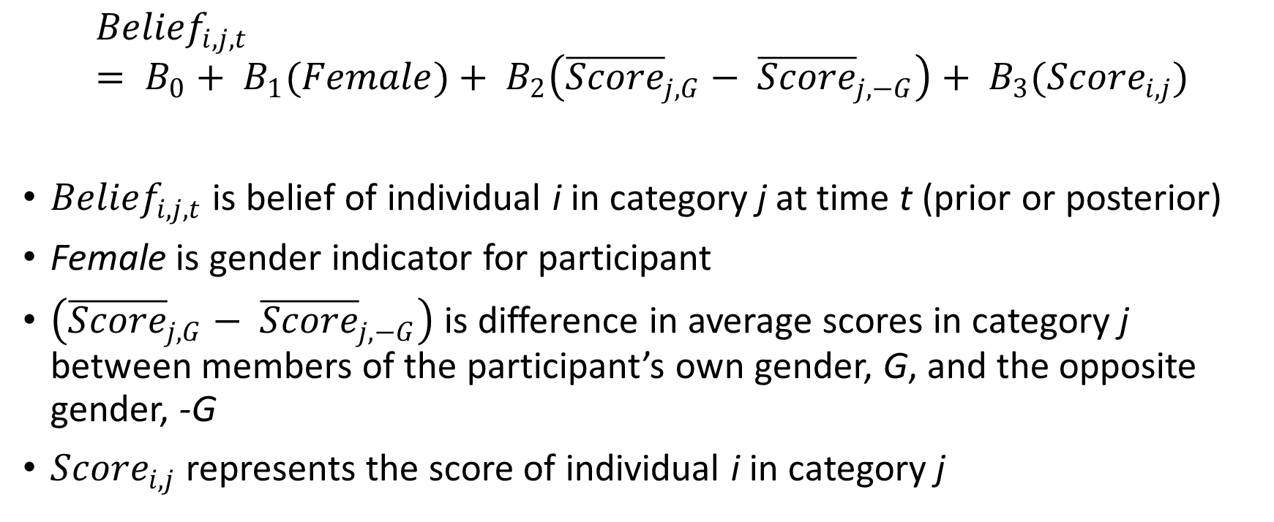
Approach to studying the role of stereotypes
$${Belief}_{i,j,t}= B_{0}+ B_{1}(Female)+ B_{2}\left({\overline{Score}}_{j,G}− {\overline{Score}}_{j,−G}\right)+ B_{3}({Score}_{i,j})$$
${Belief}_{i,j,t}$ is belief of individual i in category j at time t (prior or posterior)
Female is gender indicator for participant
$\left({\overline{Score}}_{j,G}− {\overline{Score}}_{j,−G}\right)$ is difference in average scores in category j between members of the participant’s own gender, G, and the opposite gender, -G
${Score}_{i,j}$ represents the score of individual i in category j

Slide 19
Notes on specifications
Beliefs: focus on guess of score – intuitive & transparent
  Results similar if you predict mean of full distribution
Measurement error: Gillen et al (2019) flag that measurement error in control variables can bias coefficients of interest
  Concern: score is only a noisy measure of ability & unobserved ability may be correlated with gender or own gender advantage
  Solution: Add to our specifications a second proxy for individual performance, the average performance of one’s own gender in the category
Controls: estimate model with demographic controls, round fixed effects

Slide 20
Question 1a
Do gender stereotypes predict beliefs - even after the provision of noisy feedback?
Does this depend on the noisiness of the signal?

Slide 21
Question 2
Do gender stereotypes predict posterior beliefs, even conditional on the Bayesian-predicted posterior?

Slide 22
Bayesian Predictions
We can use Bayesian model to predict the posterior belief of each participant given prior distribution and signal received
Use these predictions to ask whether the impact of stereotypes on posteriors is Bayesian
  Bayesian channel: at least some of stereotype bias in priors will carry over into posteriors
  Or, a non-Bayesian channel: even conditional on Bayesian prediction, we see some impact of stereotypes on posterior beliefs – i.e. gender-type of category matters for how participants update beliefs

Slide 23
Bayesian Predictions
With our signal structure, the BP for most participants is either:
Guess of score should be the signal she observed
Guess of score should be the same as her prior guess
Oversimplifying – either believe the signal or ignore it
Signals are accurate enough that…
If a participant assigned sufficient probability to the signal in her prior, she should update her guess of her score to that signal after observing it
If she did not put sufficient weight on the signal ex ante, then she should continue to report her prior guess as her posterior guess

Slide 24
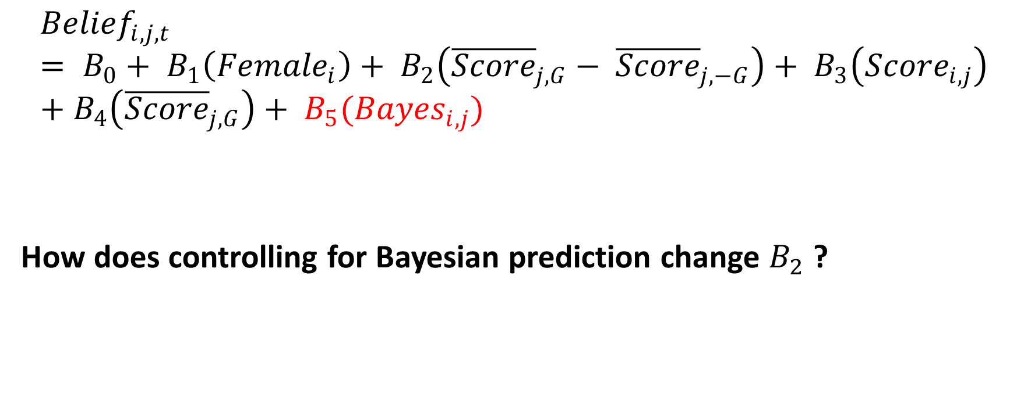
Incorporating Bayesian Predictions
$${Belief}_{i,j,t}= B_{0}+ B_{1}\left({Female}_{i}\right)+ B_{2}\left({\overline{Score}}_{j,G}− {\overline{Score}}_{j,−G}\right)+ B_{3}\left({Score}_{i,j}\right)+B_{4}\left({\overline{Score}}_{j,G}\right)+ B_{5}({Bayes}_{i,j})$$
How does controlling for Bayesian prediction change $B_{2}$ ?

Slide 25
Question 3
Are there gender differences in conservatism?
How do these differences depend upon the gender-type of the domain?

Slide 26
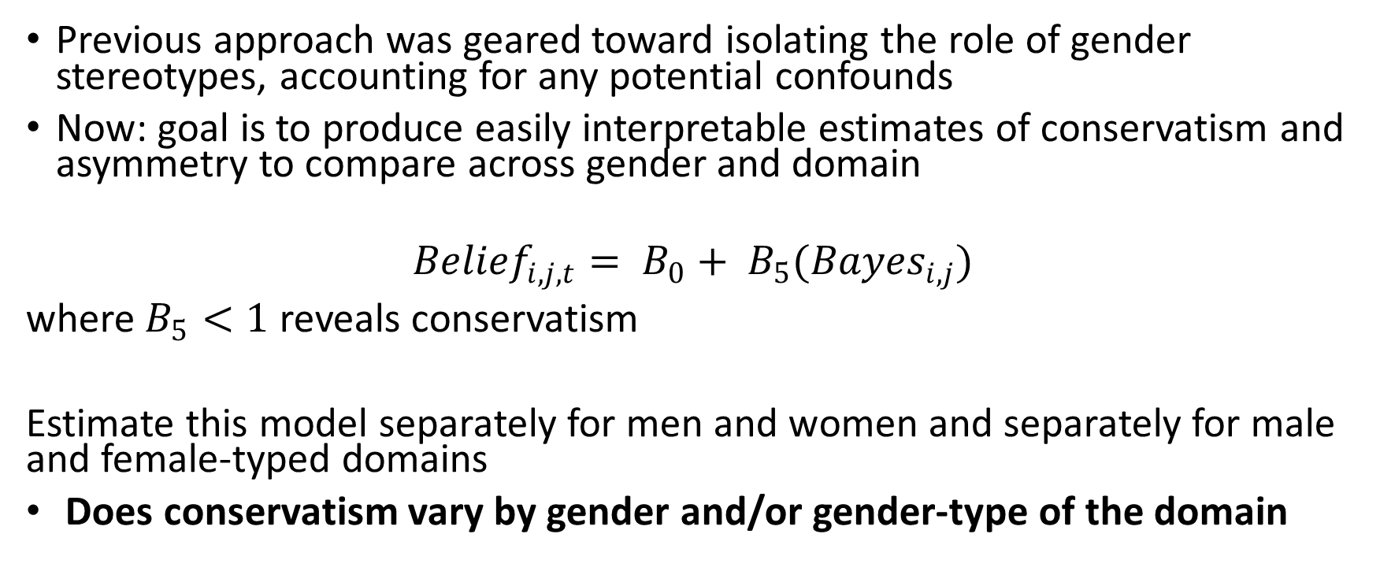
Conservatism
Previous approach was geared toward isolating the role of gender stereotypes, accounting for any potential confounds
Now: goal is to produce easily interpretable estimates of conservatism and asymmetry to compare across gender and domain
$${Belief}_{i,j,t}= B_{0}+ B_{5}({Bayes}_{i,j})$$
where $B_{5}<1$ reveals conservatism
Estimate this model separately for men and women and separately for male and female-typed domains
Does conservatism vary by gender and/or gender-type of the domain

Slide 27
Stereotype-Consistent News
Hypothesis on conservatism should be more nuanced:
  Individuals should be more responsive to good news in congruent domains
  But, less responsive to bad news in those same domains
Idea: individuals should respond more to “stereotype-consistent” news
Suggests a need to consider the type of news received

Slide 28
Question 4
Are there gender differences in responses to good news? Do these differences depend upon the gender-type of the domain?
Are there gender differences in responses to bad news? Do these differences depend upon the gender-type of the domain?

Slide 29
Asymmetry
Define good news as signal equal to or above true score; bad news is signal below true score
  Choose to include truthful news as “good news” since it is more likely that a truthful draw is greater than a participant’s prior guess (61% of cases) then below a participant’s prior guess (26% of cases).
Signal displayed is exogenous conditional on performance,
  No selection on priors or performance
Results similar if you define news relative to priors

Slide 30
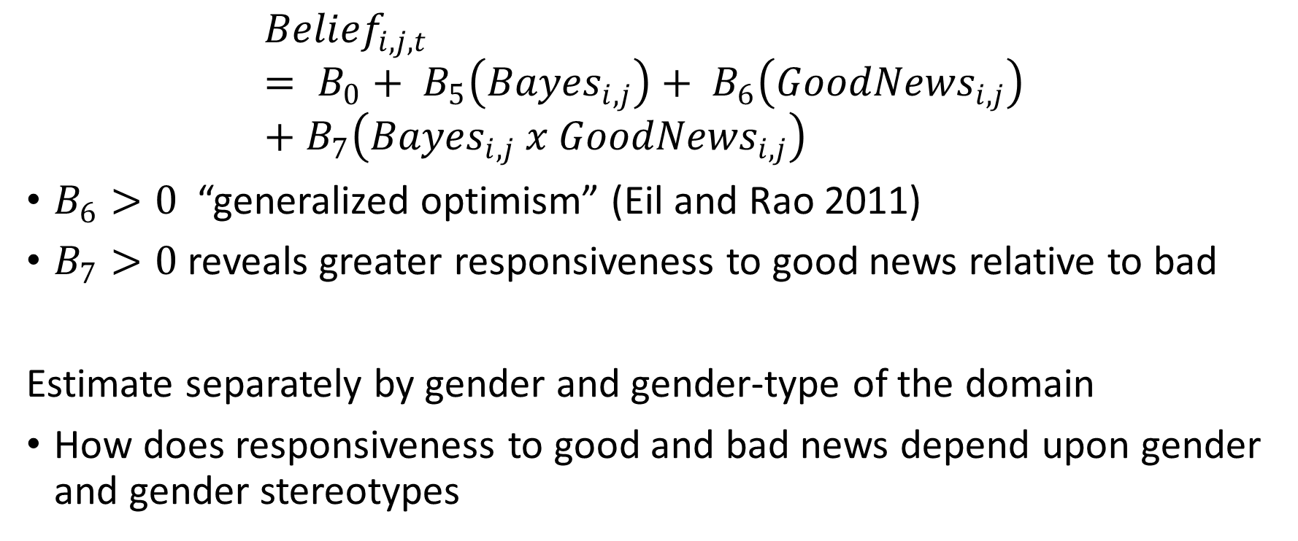
Asymmetry
$${Belief}_{i,j,t}= B_{0}+ B_{5}\left({Bayes}_{i,j}\right)+ B_{6}\left({GoodNews}_{i,j}\right)+B_{7}\left({Bayes}_{i,j} x {GoodNews}_{i,j}\right)$$
$B_{6}>0$ “generalized optimism” (Eil and Rao 2011)
$B_{7}>0$ reveals greater responsiveness to good news relative to bad
Estimate separately by gender and gender-type of the domain
How does responsiveness to good and bad news depend upon gender and gender stereotypes

Slide 31
Results

Slide 32
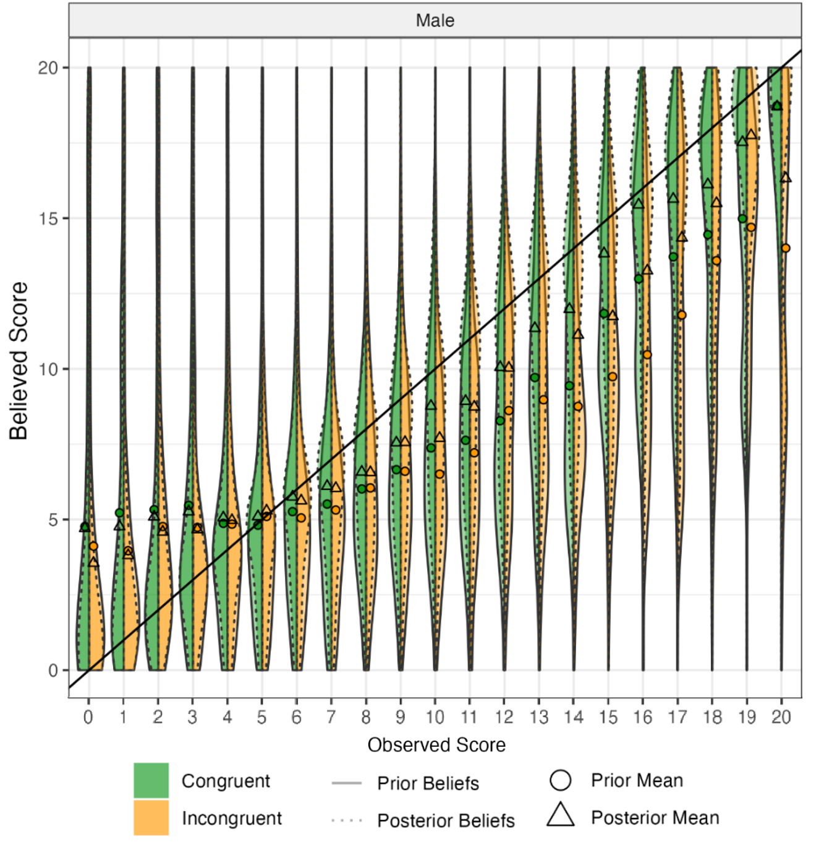

Slide 33
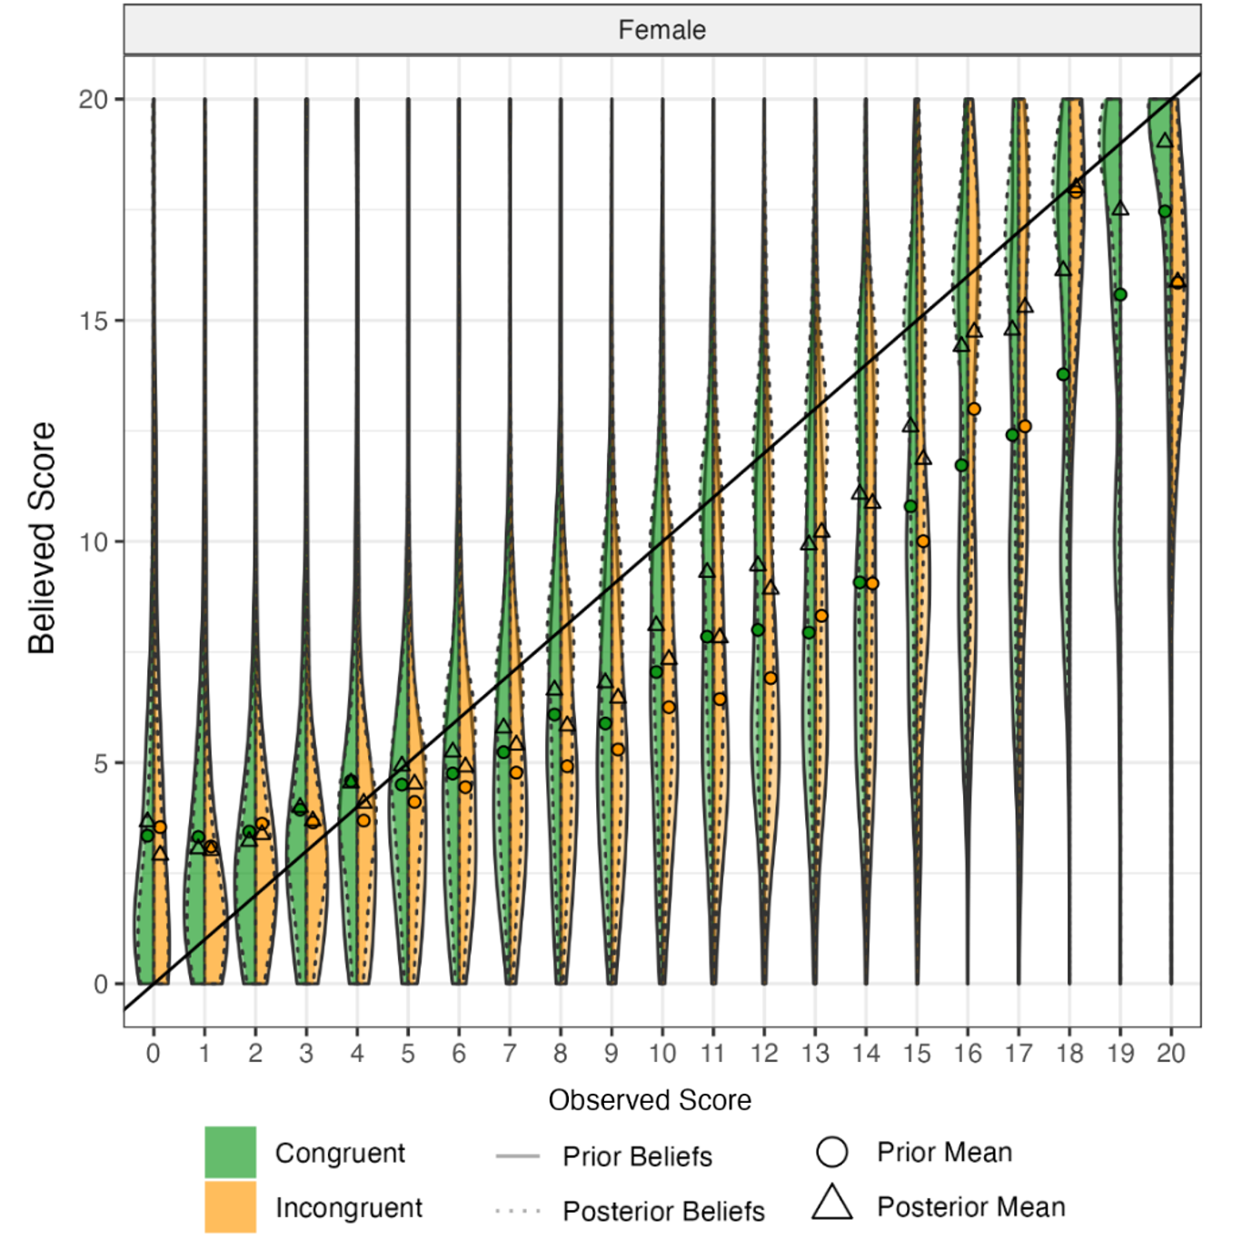

Slide 34
Observations
Beliefs track true scores, suggesting attentiveness and understanding
Individuals under-estimate their scores on average, with the extent of this under-confidence increasing in observed performance
Before feedback, individuals (both men and women) more confident in gender congruent than gender incongruent categories, conditional on observed performance
  Consistent with Coffman (2014) and Bordalo et al (2019)
Feedback seems to help move people in the direction of the truth
  Shape of the distributions illustrate more “bunching” on accurate beliefs
But, feedback does not seem to close the gaps between beliefs in congruent and incongruent categories

Slide 35
Question 1
Do gender stereotypes predict beliefs - even after the provision of noisy feedback?

Slide 36
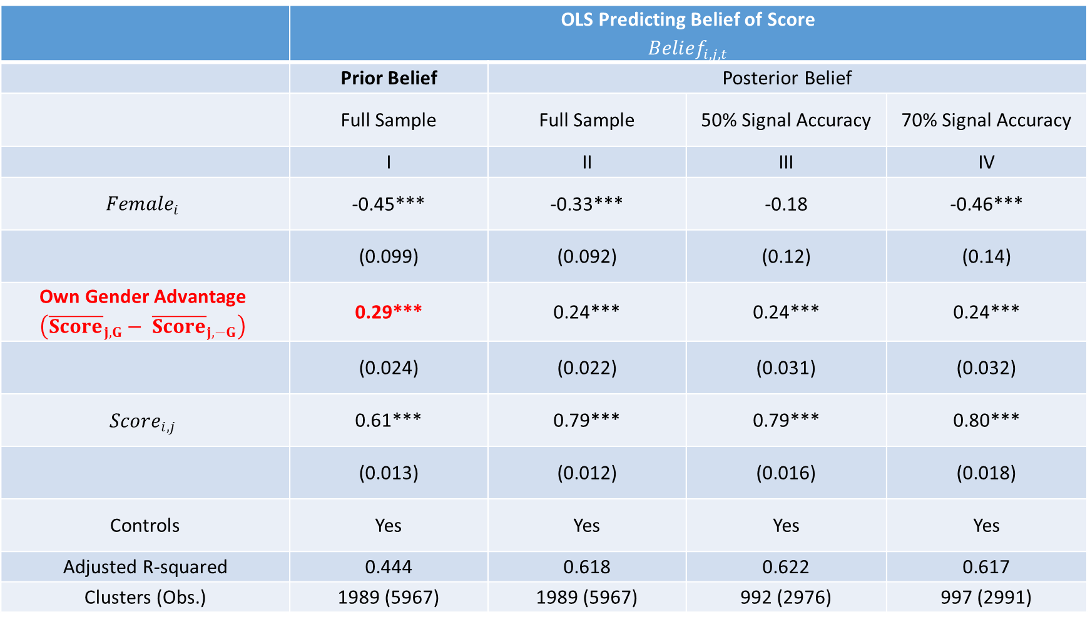
 | OLS Predicting Belief of Score $${Belief}_{i,j,t}$$
 | Prior Belief | Posterior Belief
 | Full Sample | Full Sample | 50% Signal Accuracy | 70% Signal Accuracy
 | I | II | III | IV
$${Female}_{i}$$ | -0.45*** | -0.33*** | -0.18 | -0.46***
 | (0.099) | (0.092) | (0.12) | (0.14)
Own Gender Advantage $$\left({\overline{Score}}_{j,G}− {\overline{Score}}_{j,−G}\right)$$ | 0.29*** | 0.24*** | 0.24*** | 0.24***
 | (0.024) | (0.022) | (0.031) | (0.032)
$${Score}_{i,j}$$ | 0.61*** | 0.79*** | 0.79*** | 0.80***
 | (0.013) | (0.012) | (0.016) | (0.018)
Controls | Yes | Yes | Yes | Yes
Adjusted R-squared | 0.444 | 0.618 | 0.622 | 0.617
Clusters (Obs.) | 1989 (5967) | 1989 (5967) | 992 (2976) | 997 (2991)
Notes: * indicates significance at p<0.10, ** at p<0.05, *** at p<0.01, and **** at p<0.001. Controls are a dummy for whether participant attended high school in the United States, dummies for each race category, dummies for each education category, fixed effects for round, average score in the category for the participant's own gender, and number of ASVAB questions answered correctly.

Slide 37
An aside on shape of priors
Have just shown you results in terms of guesses of score, but we do have full distributions
  Results look nearly identical if you compute the means from the distribution provided
Some descriptives on shapes of priors
  Overall: Median range of prior is 4 points; 21% of distributions are symmetric; 39% left-skewed (mean<median); 40% right-skewed
  Gender differences: women report narrower, less variant, slightly more right-skewed priors
  Gender stereotypes: People put more mass on mode of prior in gender congruent categories; no range or symmetry differences; slightly more variance in gender congruent categories

Slide 38
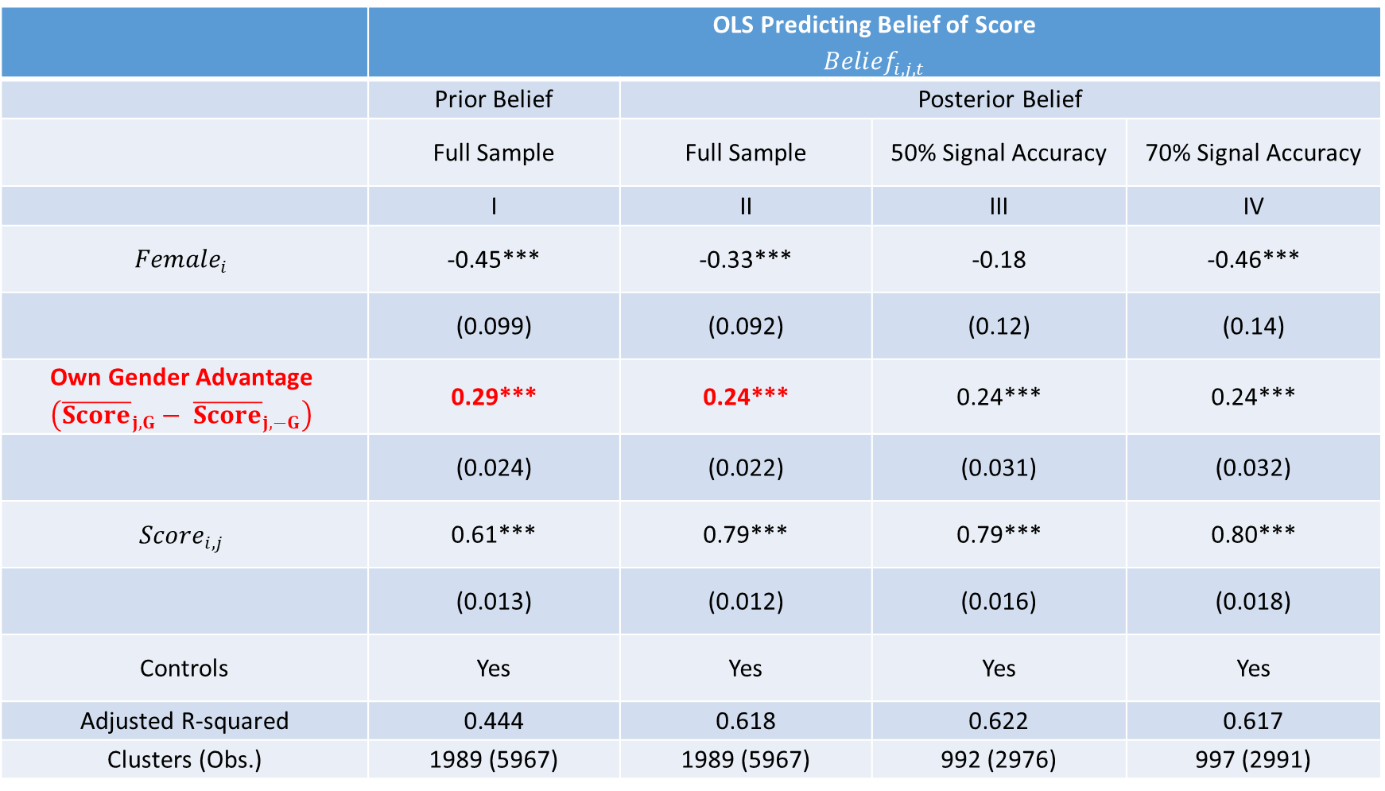
 | OLS Predicting Belief of Score $${Belief}_{i,j,t}$$
 | Prior Belief | Posterior Belief
 | Full Sample | Full Sample | 50% Signal Accuracy | 70% Signal Accuracy
 | I | II | III | IV
$${Female}_{i}$$ | -0.45*** | -0.33*** | -0.18 | -0.46***
 | (0.099) | (0.092) | (0.12) | (0.14)
Own Gender Advantage $$\left({\overline{Score}}_{j,G}− {\overline{Score}}_{j,−G}\right)$$ | 0.29*** | 0.24*** | 0.24*** | 0.24***
 | (0.024) | (0.022) | (0.031) | (0.032)
$${Score}_{i,j}$$ | 0.61*** | 0.79*** | 0.79*** | 0.80***
 | (0.013) | (0.012) | (0.016) | (0.018)
Controls | Yes | Yes | Yes | Yes
Adjusted R-squared | 0.444 | 0.618 | 0.622 | 0.617
Clusters (Obs.) | 1989 (5967) | 1989 (5967) | 992 (2976) | 997 (2991)
Notes: * indicates significance at p<0.10, ** at p<0.05, *** at p<0.01, and **** at p<0.001. Controls are a dummy for whether participant attended high school in the United States, dummies for each race category, dummies for each education category, fixed effects for round, average score in the category for the participant's own gender, and number of ASVAB questions answered correctly.

Slide 39
Question 1a
Do gender stereotypes predict beliefs - even after the provision of noisy feedback?
Does this depend on the noisiness of the signal?

Slide 40

 | OLS Predicting Belief of Score $${Belief}_{i,j,t}$$
 | Prior Belief | Posterior Belief
 | Full Sample | Full Sample | 50% Signal Accuracy | 70% Signal Accuracy
 | I | II | III | IV
$${Female}_{i}$$ | -0.45*** | -0.33*** | -0.18 | -0.46***
 | (0.099) | (0.092) | (0.12) | (0.14)
Own Gender Advantage $$\left({\overline{Score}}_{j,G}− {\overline{Score}}_{j,−G}\right)$$ | 0.29*** | 0.24*** | 0.24*** | 0.24***
 | (0.024) | (0.022) | (0.031) | (0.032)
$${Score}_{i,j}$$ | 0.61*** | 0.79*** | 0.79*** | 0.80***
 | (0.013) | (0.012) | (0.016) | (0.018)
Controls | Yes | Yes | Yes | Yes
Adjusted R-squared | 0.444 | 0.618 | 0.622 | 0.617
Clusters (Obs.) | 1989 (5967) | 1989 (5967) | 992 (2976) | 997 (2991)
Notes: * indicates significance at p<0.10, ** at p<0.05, *** at p<0.01, and **** at p<0.001. Controls are a dummy for whether participant attended high school in the United States, dummies for each race category, dummies for each education category, fixed effects for round, average score in the category for the participant's own gender, and number of ASVAB questions answered correctly.

Slide 41
Result 1: Gender stereotypes continue to predict beliefs after the provision of noisy feedback.
Result 1a: More informative signals are no more effective in reducing the impact of stereotypes on posterior beliefs.

Slide 42
Average change in beliefs

Slide 43
Descriptives on Posterior Beliefs

Slide 44
Question 2
Do gender stereotypes predict posterior beliefs, even conditional on the Bayesian-predicted posterior?

Slide 45
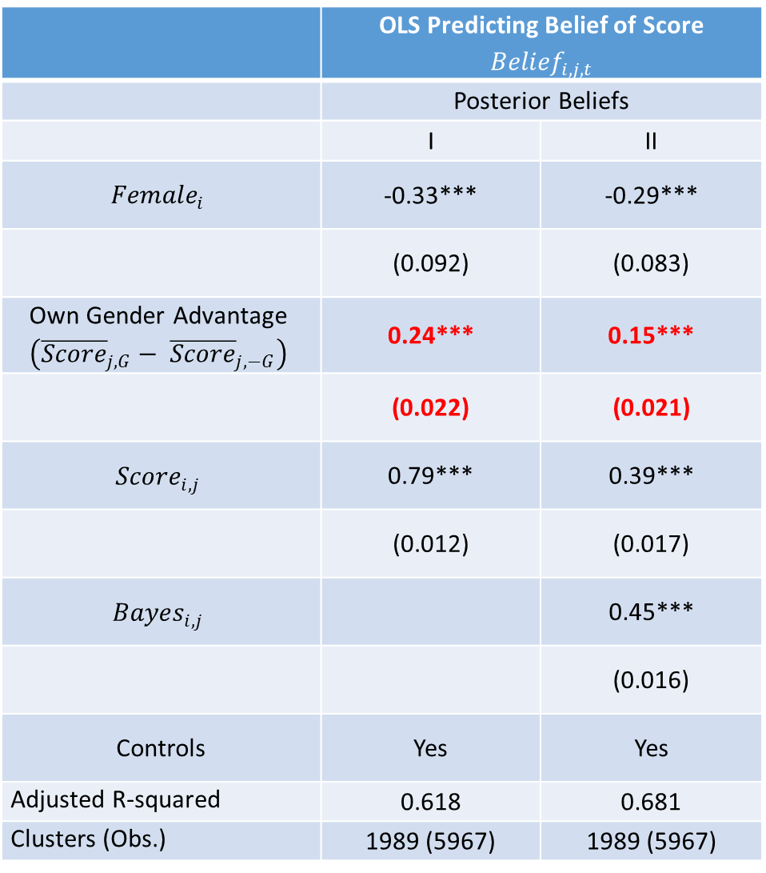
 | OLS Predicting Belief of Score $${Belief}_{i,j,t}$$
 | Posterior Beliefs
 | I | II
$${Female}_{i}$$ | -0.33*** | -0.29***
 | (0.092) | (0.083)
Own Gender Advantage $$\left({\overline{Score}}_{j,G}− {\overline{Score}}_{j,−G}\right)$$ | 0.24*** | 0.15***
 | (0.022) | (0.021)
$${Score}_{i,j}$$ | 0.79*** | 0.39***
 | (0.012) | (0.017)
$${Bayes}_{i,j}$$ |  | 0.45***
 |  | (0.016)
Controls | Yes | Yes
Adjusted R-squared | 0.618 | 0.681
Clusters (Obs.) | 1989 (5967) | 1989 (5967)

Slide 46
Result 2: Gender stereotypes predict posterior beliefs, in excess of what the Bayesian model would predict.

Slide 47
Question 3
Are there gender differences in conservatism?
How do these differences depend upon the gender-type of the domain?

Slide 48
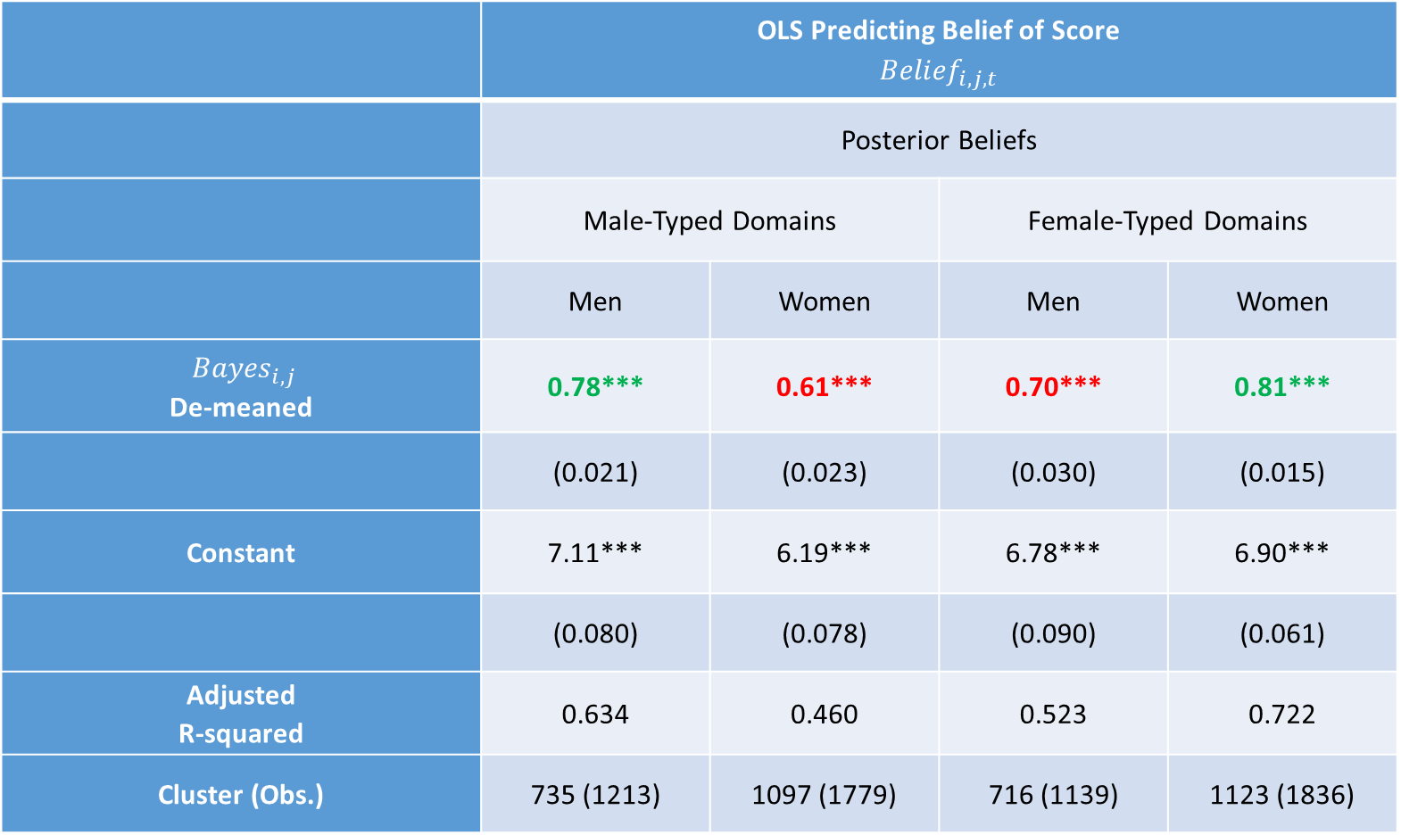
 | OLS Predicting Belief of Score $${Belief}_{i,j,t}$$
 | Posterior Beliefs
 | Male-Typed Domains |  | Female-Typed Domains
 | Men | Women | Men | Women
${Bayes}_{i,j}$ De-meaned | 0.78*** | 0.61*** | 0.70*** | 0.81***
 | (0.021) | (0.023) | (0.030) | (0.015)
Constant | 7.11*** | 6.19*** | 6.78*** | 6.90***
 | (0.080) | (0.078) | (0.090) | (0.061)
Adjusted R-squared | 0.634 | 0.460 | 0.523 | 0.722
Cluster (Obs.) | 735 (1213) | 1097 (1779) | 716 (1139) | 1123 (1836)
Notes: * indicates significance at p<0.10, ** at p<0.05, *** at p<0.01, and **** at p<0.001. Male-typed are categories that have an average positive value on slider scale rating (Cars, Sports, Videogames, Business); female-typed are categories that have an average negative value on slider scale rating (Kardashians, Disney, Art, Verbal). The Bayesian predictions are de-meaned by differencing out the mean Bayesian prediction in the full sample.

Slide 49
Observations
Overall → replicate past findings of conservatism (under-inference from signals)
For both men and women, posteriors are more responsive to the Bayesian prediction when the domain is gender congruent
  Men’s responsiveness falls from 0.78 to 0.70 when we move from male-typed to female-typed categories
  Women’s responsiveness falls from 0.81 to 0.61 when moving from female-typed to male-typed categories.
Bayesian model better predicts posterior beliefs in gender congruent categories
  Can see this in adjusted R-squared as well

Slide 50
Result 3: Men and women update their beliefs less conservatively in gender congruent domains.

Slide 51
Question 4
Are there gender differences in responses to good news? Do these differences depend upon the gender-type of the domain?
Are there gender differences in responses to bad news? Do these differences depend upon the gender-type of the domain?

Slide 53
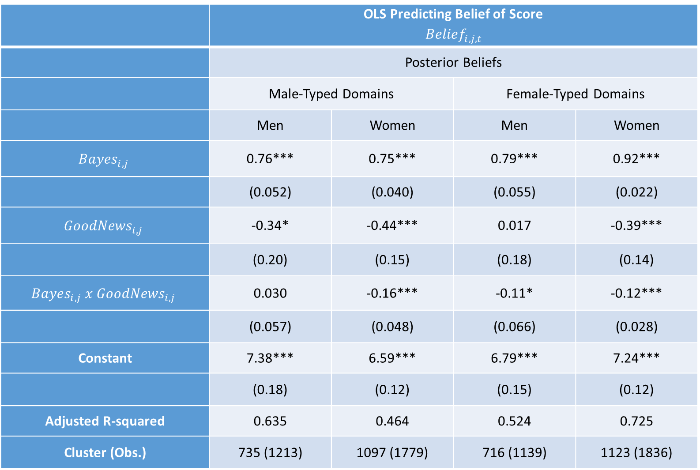
 | OLS Predicting Belief of Score $${Belief}_{i,j,t}$$
 | Posterior Beliefs
 | Male-Typed Domains |  | Female-Typed Domains
 | Men | Women | Men | Women
$${Bayes}_{i,j}$$ | 0.76*** | 0.75*** | 0.79*** | 0.92***
 | (0.052) | (0.040) | (0.055) | (0.022)
$${GoodNews}_{i,j}$$ | -0.34* | -0.44*** | 0.017 | -0.39***
 | (0.20) | (0.15) | (0.18) | (0.14)
$${Bayes}_{i,j} x {GoodNews}_{i,j}$$ | 0.030 | -0.16*** | -0.11* | -0.12***
 | (0.057) | (0.048) | (0.066) | (0.028)
Constant | 7.38*** | 6.59*** | 6.79*** | 7.24***
 | (0.18) | (0.12) | (0.15) | (0.12)
Adjusted R-squared | 0.635 | 0.464 | 0.524 | 0.725
Cluster (Obs.) | 735 (1213) | 1097 (1779) | 716 (1139) | 1123 (1836)

Slide 54
Observations
Male-typed domains:
  On average, men report more optimistic beliefs than women after good news or bad news
  No evidence of “generalized optimism” for men nor women - beliefs after good news are shifted down, not up, relative to BP
  Men and women display similar responsiveness to bad news – estimated coefficient on BP 0.75 for both
  Men significantly more responsive to good news than women -- estimated coefficient of 0.79 for men and 0.59 for women

Slide 55
Observations
Female-typed domains
  Still no evidence of generalized optimism
  Women report more optimistic beliefs than men after bad news on average
  Women are more responsive – both to good news and bad – than men
    For bad news, responsiveness of 0.92 for women and 0.79 for men, p<0.01
    For good news, responsiveness of 0.80 for women and 0.68 for men, p<0.01

Slide 56
Observations
Findings may be tied to baseline level of under-confidence in our data
  Individuals under-estimate their scores in their priors
  And, are conservative relative to the Bayesian benchmark
  Combined → this can produce “generalized pessimism” after good news
In contrast, previous studies that have considered environments with baseline over-confidence could more readily generate “generalized optimism” after good news through conservatism
  Helps provide a framework for interpreting mixed results

Slide 57
Asymmetry Responsiveness Summary
 | Gender Congruent | Gender Incongruent
Good News | M: 0.79 W: 0.80 | M: 0.68 W: 0.59
Bad News | M: 0.76 W: 0.92 | M: 0.79 W: 0.75

Slide 58
Asymmetry – Responsiveness Summary
Men and women similarly responsive to good news in gender congruent domains
 | Gender Congruent | Gender Incongruent
Good News | M: 0.79 W: 0.80 | M: 0.68 W: 0.59
Bad News | M: 0.76 W: 0.92 | M: 0.79 W: 0.75

Slide 59
Asymmetry – Responsiveness Summary
 | Gender Congruent | Gender Incongruent
Good News | M: 0.79 W: 0.80 | M: 0.68 W: 0.59
Bad News | M: 0.76 W: 0.92 | M: 0.79 W: 0.75
Men and women similarly responsive to bad news in gender incongruent domains

Slide 60
Asymmetry – Responsiveness Summary
 | Gender Congruent | Gender Incongruent
Good News | M: 0.79 W: 0.80 | M: 0.68 W: 0.59
Bad News | M: 0.76 W: 0.92 | M: 0.79 W: 0.75
Both men and women more responsive to good news in gender congruent domains than gender incongruent domains

Slide 61
Asymmetry – Responsiveness Summary
 | Gender Congruent | Gender Incongruent
Good News | M: 0.79 W: 0.80 | M: 0.68 W: 0.59
Bad News | M: 0.76 W: 0.92 | M: 0.79 W: 0.75
Women more responsive to bad news than good news

Slide 62
Asymmetry – Responsiveness Summary
 | Gender Congruent | Gender Incongruent
Good News | M: 0.79 W: 0.80 | M: 0.68 W: 0.59
Bad News | M: 0.76 W: 0.92 | M: 0.79 W: 0.75
MEN:
Least responsive to good news in incongruent domains

Slide 63
Asymmetry – Responsiveness Summary
 | Gender Congruent | Gender Incongruent
Good News | M: 0.80 W: 0.79 | M: 0.67 W: 0.59
Bad News | M: 0.75 W: 0.92 | M: 0.78 W: 0.75
WOMEN:
Least responsive to good news in incongruent domains

Slide 64
Takeaways on asymmetry
Individuals are more responsive to good news in gender congruent domains
  Gender stereotypes matter for understanding asymmetry. Greater responsiveness to good news predicted by stereotype, NOT gender.
Women generally more responsive to bad news than good news (in both male and female-typed domains)
Hardest to convince people that they are better than they expected in gender incongruent domains

Slide 65
Result 4a: The gender gap in responsiveness to good news depends upon the gender-type of the domain
In male-typed domains, men are more responsive to good news than women.
But, in female-typed domains, the gap is reversed.
(Null) Result 4b: The gender gap in responsiveness to bad news does not vary systematically with the gender-type of the domain.

Slide 66
Robustness and other approaches
In paper we show:
  Results cannot be explained by confirmation bias
  Ego-relevance hypothesis would predict opposite pattern of what we find: we find individuals more responsive in gender congruent domains
    Reconcile through role of baseline degree of under/over confidence?
  Kitchen sink approach that includes all observables reduces role of stereotypes in shaping posterior beliefs → extent of underconfidence matters

Slide 67
Conclusions
Explore the effectiveness of feedback in closing gender gaps in beliefs of own ability
Information not as effective as we might hope (or as effective as a Bayesian model would predict) in eliminating gender gaps
  Posteriors are closer to Bayesian predictions in gender congruent domains
  Greater responsiveness to good news in gender congruent domains
As if individuals respond more to stereotype-confirming (good) news
Suggests that convincing individuals of their talent in gender incongruent areas might be harder than we expect

