Slide 1
What Do Happiness Data Mean?
Theory and Survey Evidence
Daniel J. Benjamin
Jakina Debnam Guzman
Marc Fleurbaey
Ori Heffetz
Miles Kimball

Slide 2
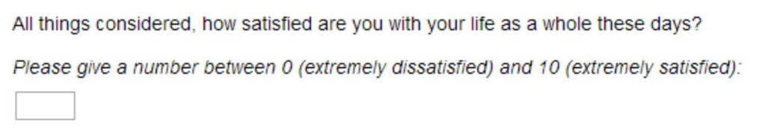
Introduction
Self-reported well-being (SWB) questions,
e.g., about happiness and life satisfaction,
are increasingly used by economists and
other social scientists
Although originally, these questions were not designed to match a specific utility notion, some applications currently use SWB data as measures of the utility that would be revealed by well-informed, deliberated choices, were they observed
Increasing evidence of systematic deviations of choices (hypothetical and real) from what people believe would maximize SWB casts doubt on this assumption
(Benjamin, Heffetz, Kimball, and Rees-Jones, 2012, 2014; Fleurbaey and Schwandt, 2016)
Notes:
To add?
These provide a different indicator of success and economic growth and can compare between different societies.

Slide 3
Introduction
Many other applications seem to assume—often without stating so explicitly—that SWB data measure a different notion of utility, such as flow utility or self-centered utility. However, these assumptions have not been tested
This paper aims to gather data on these assumptions. We wish to examine and provide evidence on what respondents mean when answering SWB questions
Our method: we conduct surveys in which respondents are asked to introspect on the way they answer SWB questions (as explained later)

Slide 4
SWB-Question Components
SWB questions have several components. We focus on these three:
Understanding these components can help interpret the utility notion measured
Life domains
Time horizons
Social circles
What life domains did the respondent think they were asked about?
E.g., income, physical health, meaning, and hobbies
What time span did the respondent consider being asked about?
E.g., today, yesterday, or entire life so far
Which individuals did the respondent think the SWB question referred to?
E.g., just myself, family, close friends, or the entire world

Slide 5
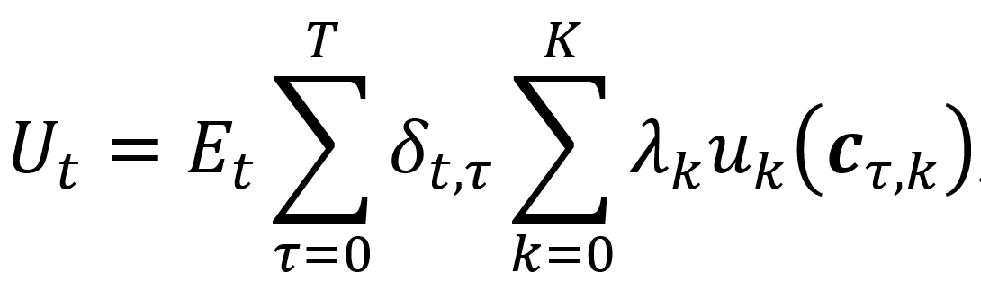
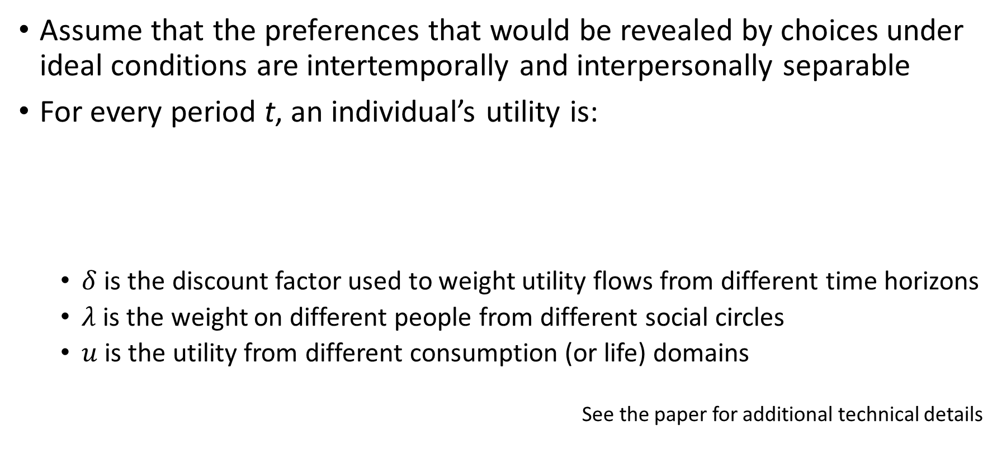
Theoretical Framework: Utility function
Assume that the preferences that would be revealed by choices under ideal conditions are intertemporally and interpersonally separable
For every period t, an individual’s utility is:
  $δ$ is the discount factor used to weight utility flows from different time horizons
  $λ$ is the weight on different people from different social circles
  $u$ is the utility from different consumption (or life) domains
See the paper for additional technical details

Slide 6
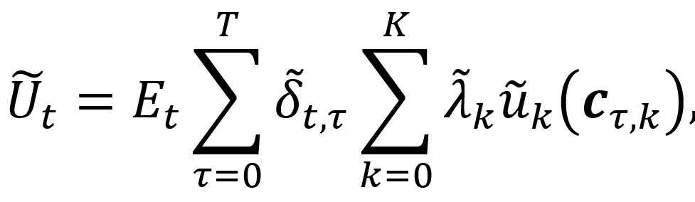
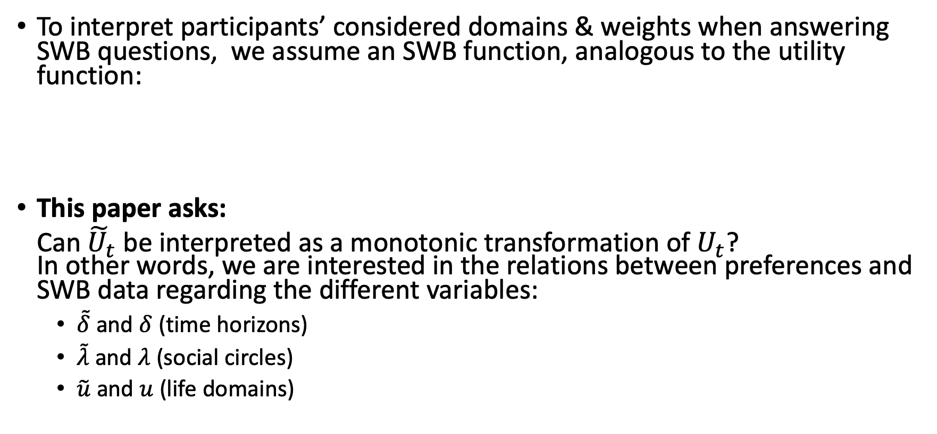
Theoretical Framework: SWB function
To interpret participants’ considered domains & weights when answering SWB questions, we assume an SWB function, analogous to the utility function:
This paper asks:
Can ${\tilde{U}}_{t}$ be interpreted as a monotonic transformation of $U_{t}$?
In other words, we are interested in the relations between preferences and SWB data regarding the different variables:
  $\tilde{δ}$ and $δ$ (time horizons)
  $\tilde{λ}$ and $λ$ (social circles)
  $\tilde{u}$ and $u$ (life domains)

Slide 7
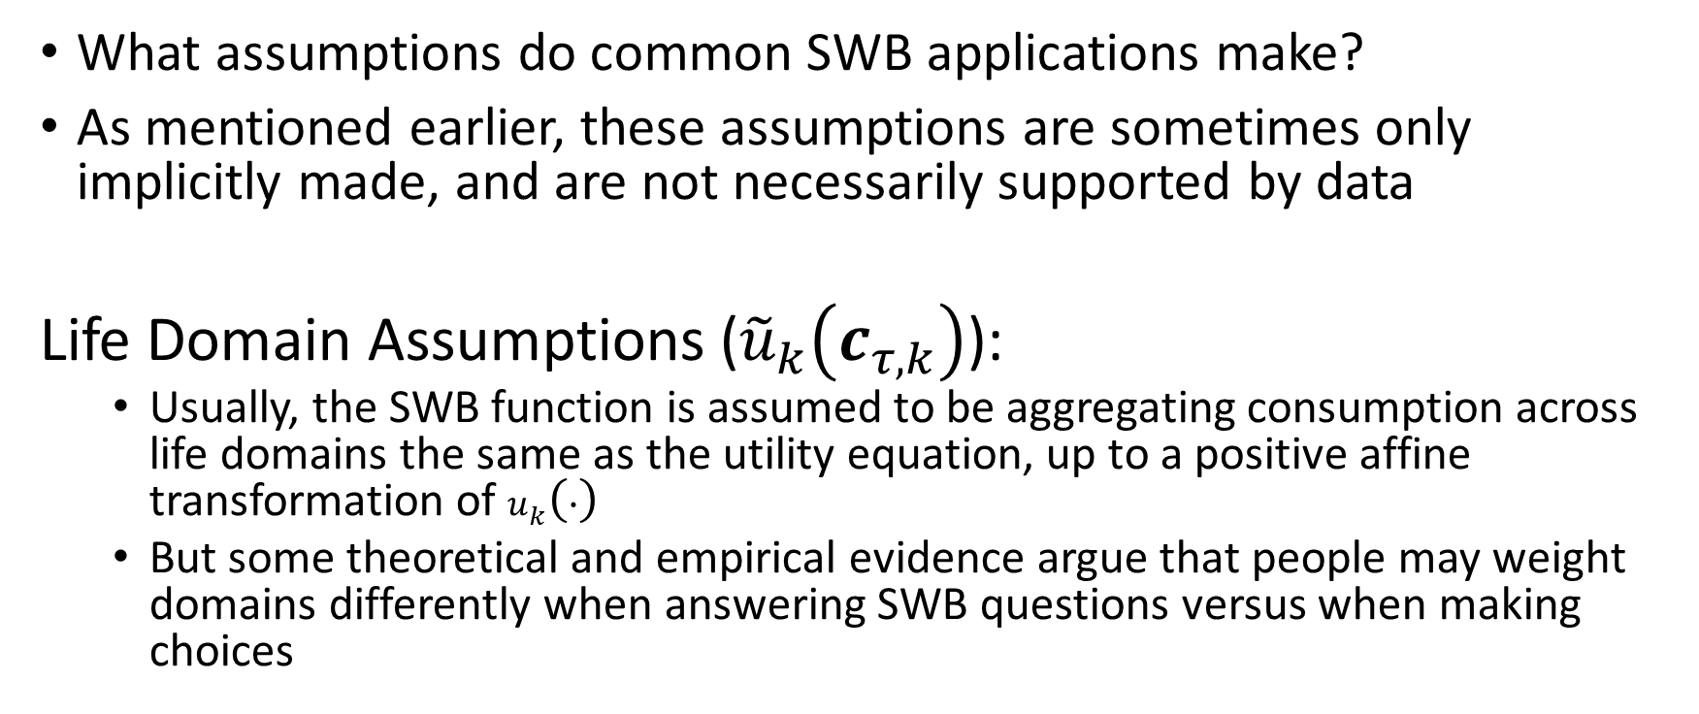
Assumptions We Study
What assumptions do common SWB applications make?
As mentioned earlier, these assumptions are sometimes only implicitly made, and are not necessarily supported by data
Life Domain Assumptions (${\tilde{u}}_{k}\left(c_{τ,k}\right)$):
  Usually, the SWB function is assumed to be aggregating consumption across life domains the same as the utility equation, up to a positive affine transformation of $u_{k}\left(∙\right)$
  But some theoretical and empirical evidence argue that people may weight domains differently when answering SWB questions versus when making choices

Slide 8

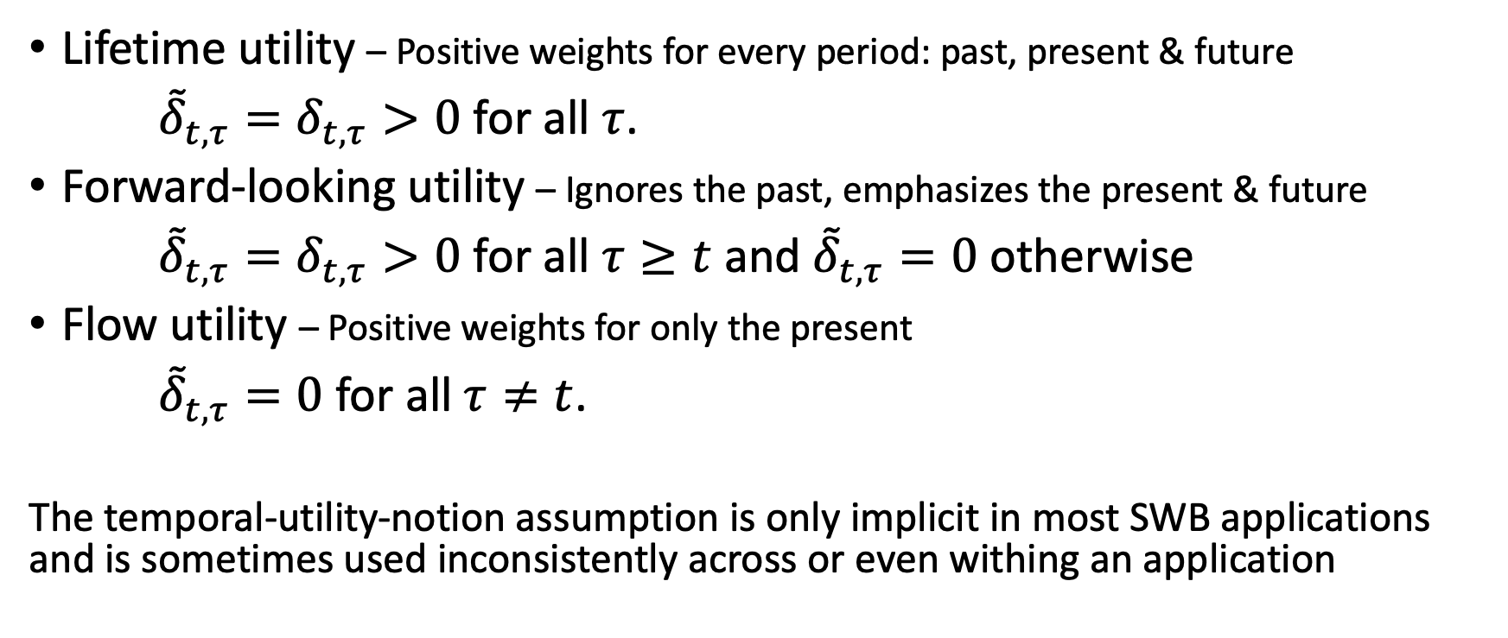
Time Horizon Assumptions (${\tilde{δ}}_{t,τ}$)
Lifetime utility – Positive weights for every period: past, present & future
${\tilde{δ}}_{t,τ}=δ_{t,τ}>0$ for all $τ$.
Forward-looking utility – Ignores the past, emphasizes the present & future
${\tilde{δ}}_{t,τ}=δ_{t,τ}>0$ for all $τ≥t$ and ${\tilde{δ}}_{t,τ}=0$ otherwise
Flow utility – Positive weights for only the present
${\tilde{δ}}_{t,τ}=0$ for all $τ≠t$.
The temporal-utility-notion assumption is only implicit in most SWB applications and is sometimes used inconsistently across or even withing an application
Notes:
backward-looking utility – does show in SWB questions, but does not correspond to any standard utility notion so is not focused on in this paper

Slide 9
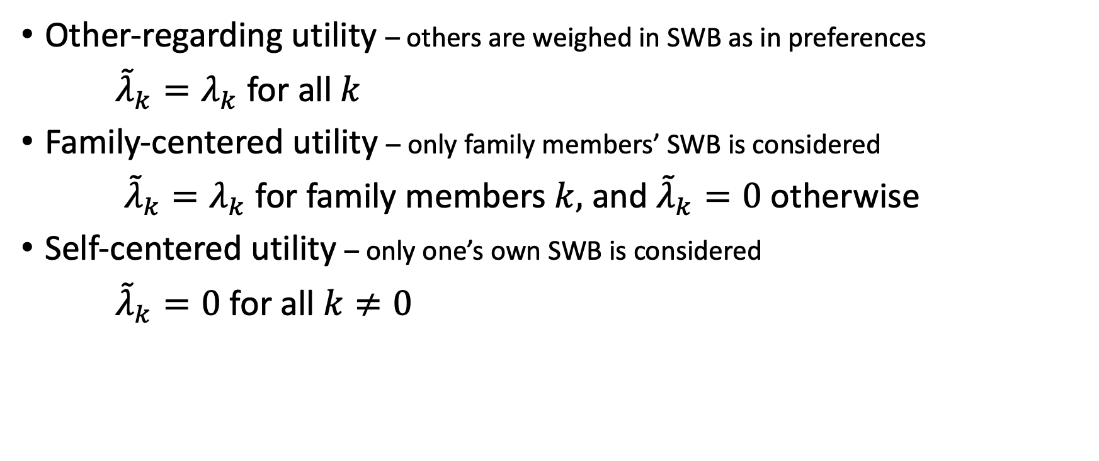

Social Circles Assumptions (${\tilde{λ}}_{k}$)
Other-regarding utility – others are weighed in SWB as in preferences
${\tilde{λ}}_{k}=λ_{k}$for all $k$
Family-centered utility – only family members’ SWB is considered
${\tilde{λ}}_{k}=λ_{k}$ for family members $k,$ and ${\tilde{λ}}_{k}=0$ otherwise
Self-centered utility – only one’s own SWB is considered
${\tilde{λ}}_{k}=0$ for all $k≠0$

Slide 10
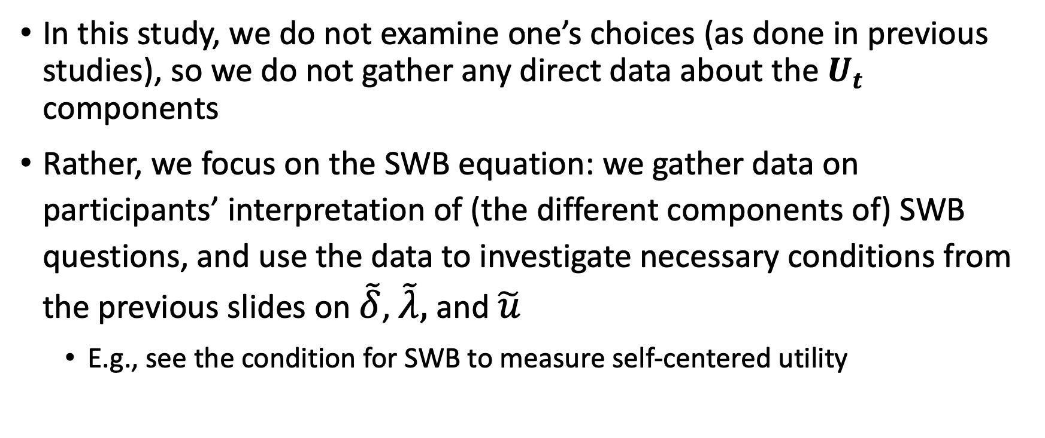
Empirical strategy
In this study, we do not examine one’s choices (as done in previous studies), so we do not gather any direct data about the $U_{t}$ components
Rather, we focus on the SWB equation: we gather data on participants’ interpretation of (the different components of) SWB questions, and use the data to investigate necessary conditions from the previous slides on $\tilde{δ}$, $\tilde{λ},$ and $\tilde{u}$
  E.g., see the condition for SWB to measure self-centered utility

Slide 11
Main Findings
Our findings suggest caution when interpreting SWB responses as capturing utility notions commonly assumed by economists. Widely used SWB measures do not seem to straightforwardly capture any specific utility notion
However, respondents are sensitive to question wording. Our findings also suggest a way to improve questions for responses to be closer to wanted notions (specifically with flow, family-centered and self-centered utilities)
We find heterogeneity across sociodemographic groups’ responses that indicate different interpretations of SWB questions; such heterogeneity can also be receded by the wording of the questions
Click to go directly to the second survey

Slide 12
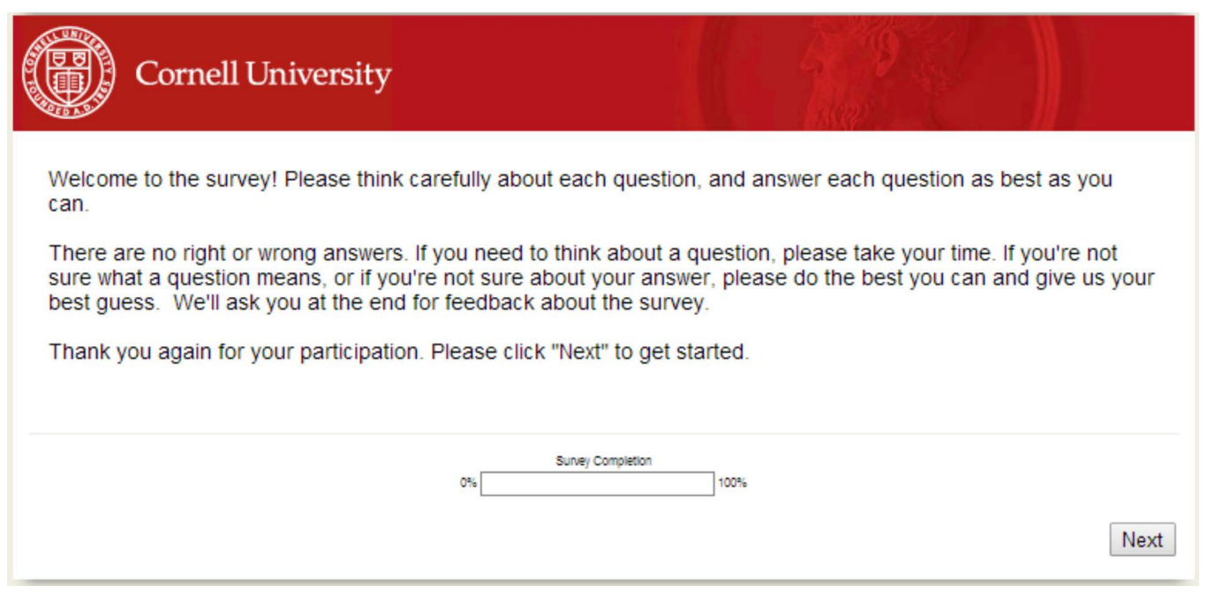
First Survey - General Information
Conducted in June 2014
Respondents recruited through “Clear Voice Research”
3,040 respondents completed the survey,
with 359-397 complete responses for each question
Median time to complete the survey: 14 minutes

Slide 13
SWB Questions
Previously researched:
Widely used standard SWB questions:
Ladder
Life Satisfaction
Happiness
Meaning & Value
New SWB questions:
Family
Well-Being
Personal Well-Being
Dealing Well
Options & Possibilities
All questions are ranked from 0 (lowest) to 10 (highest)
Click for Full wording

Slide 14
SWB Questions
The first three questions are all-purpose evaluating measures.
The others were added to achieve several goals:
  (1) Better track utility notion
  (2) Interpreted comparably across groups
  (3) Falsification tests
Meaning & Value
(1),(2),(3)
Family
Well-Being
Personal Well-Being
Dealing Well
Options & Possibilities
(1)
(1)
(2)
(1),(2),(3)
Notes:
Dealing well – 2: Evaluating response and not situation, focus on the past
Meaning & Value, Options & Possibilities – 1: add dimensions not captured in standard SWB

Slide 15
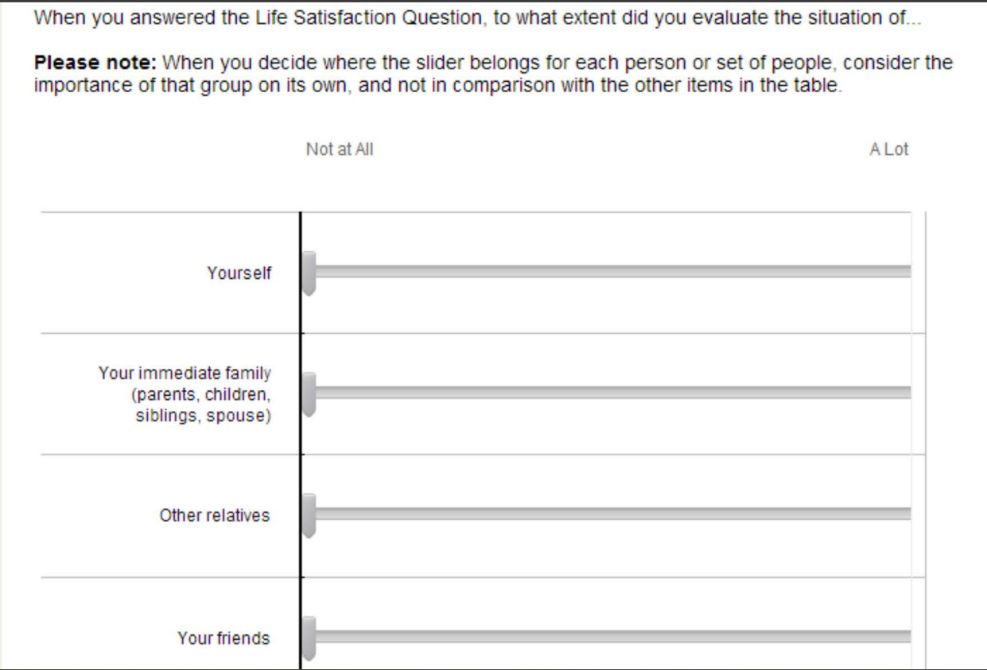
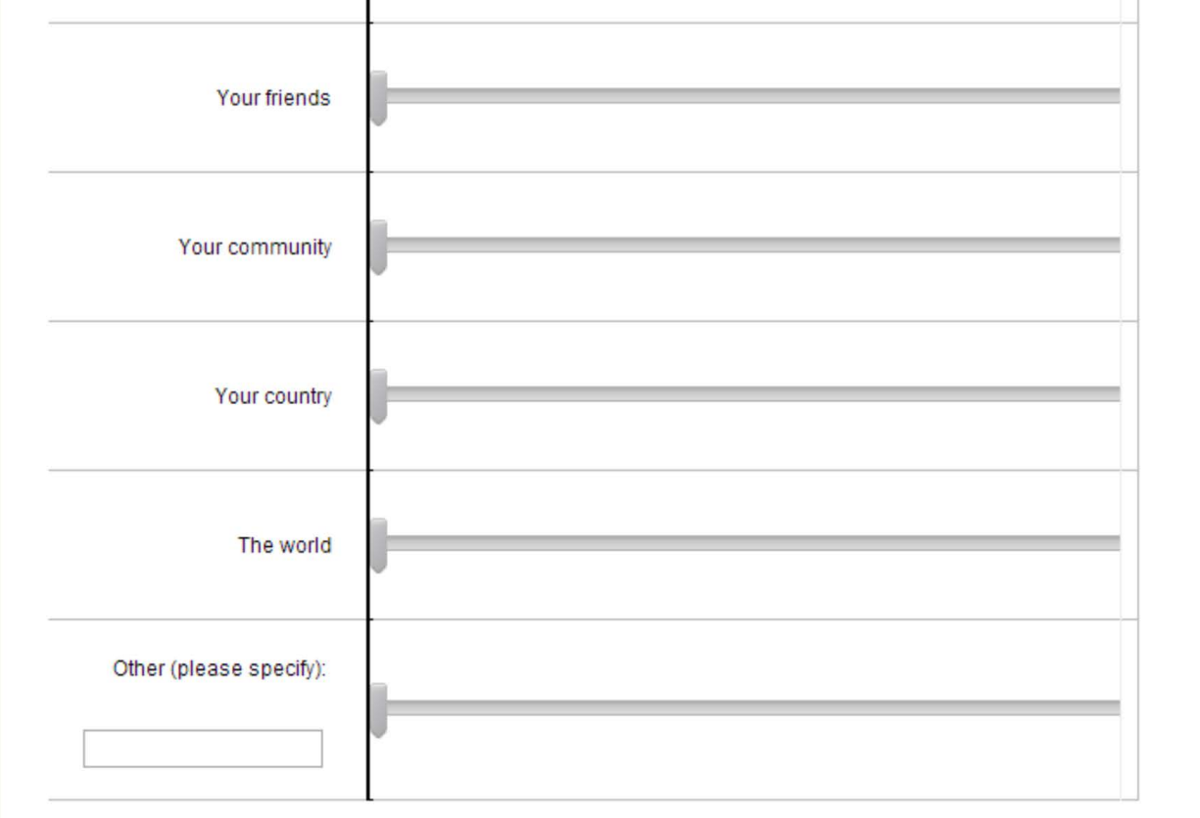
Survey Design
Example of an introspection question:
Answer one randomly assigned SWB question
Introspection of several components of the answer given, including the three utility components:
  Life domains
  Time horizons
  Social circles
  by putting weights on sliders representing several sub-domains
Many other questions, including demographic questions

Slide 16
Survey Design
Answer one randomly assigned SWB question
Introspection of several components of the answer given,
including the three utility components:
  Life domains
  Time horizons
  Social circles
  by putting weights on sliders representing several sub-domains
Many other questions, including demographic questions

Slide 17
Survey Design
Example of an introspection question:

Slide 18
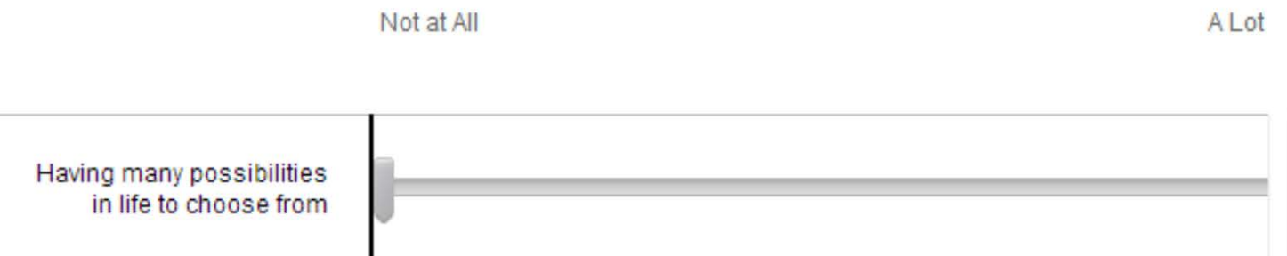
Calculating Weights
Sliders represent each possible response category:
We construct (ex post) a 0–100 response scale by dividing the distance between the labels:
  0 as “Not at all”
  100 as “A lot”
Remember:
There is no clear cardinal interpretation of the scale

Slide 19
Demographic Questions
In this paper, we focus mainly on the four widely used (in the SWB literature) sociodemographic dimensions:
  Age (18-35, 36-55, 56+)
  Sex (Men, Women)
  Income (Low, Mid, High)
  Employment status (Employed, Unemployed)
When comparing results across sociodemographic groups, differences may also reflect differences in other observable and unobservable correlates of these groups, including, e.g., differences in response-scale use.
Therefore, we examine mainly differences in the ordinal ranking

Slide 20
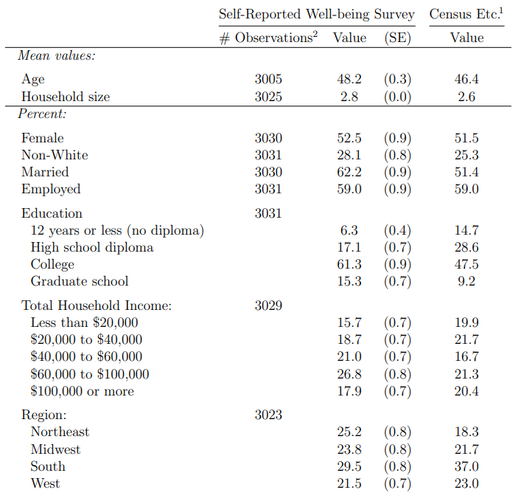
Respondents
Similar ratio to the US population in sex and employment status
Respondents are more middle-aged, with a household income that is more concentrated in the $40,000–$80,000 range
Overall, the sample resembled the US population characteristics
Notes:
Not in the 4 dimensions:
more educated and more Northeast and less South, more White, with somewhat larger households, and with higher participation in the labor force.

Slide 21
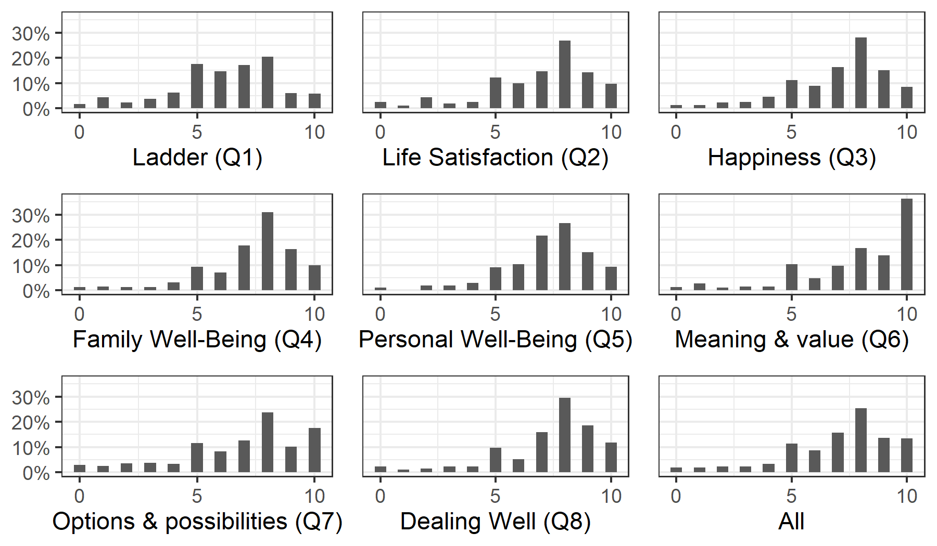
SWB Questions Results
The histograms show the distribution of the participants’ answers to the SWB questions; appear similar to previous findings in the SWB literature
Response Histograms, by SWB Question

Slide 22
Response Histograms, by SWB Question

Slide 23
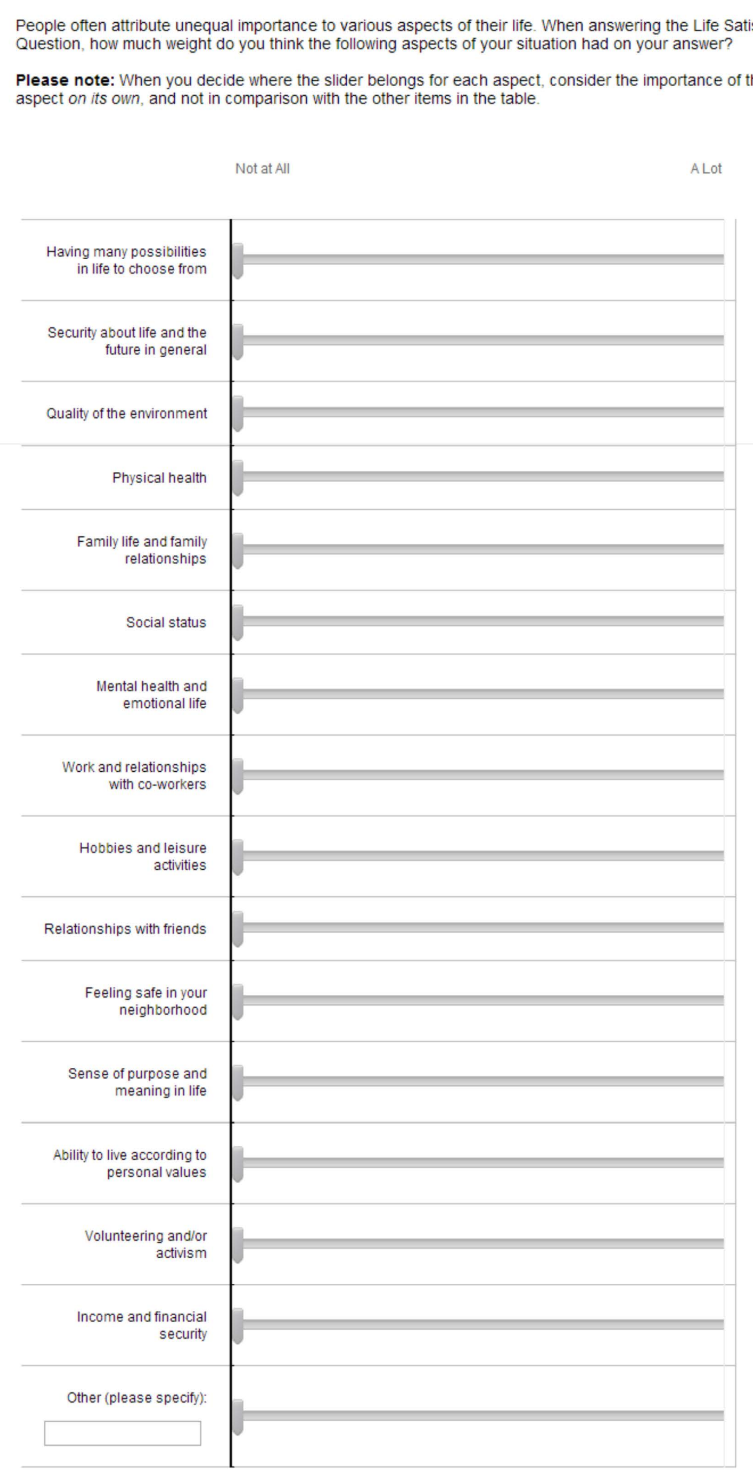
Life Domains Introspection Question

Slide 24
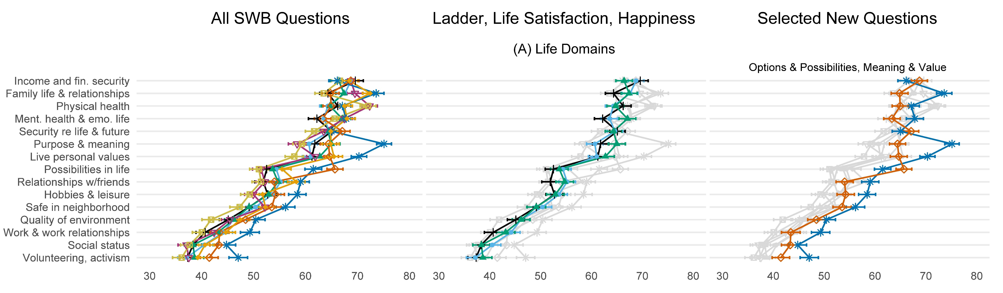

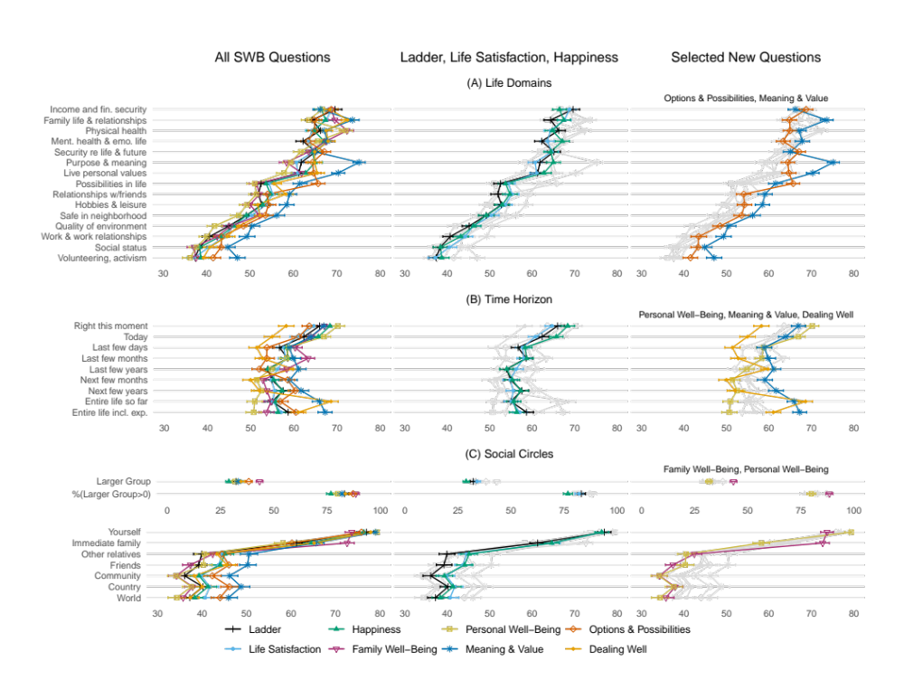
Life Domain Weights Results
On average, respondents allocate similar weights to domains across SWB questions (correlations range: 0.89-0.99)

Slide 25
Falsification Tests by Outliers
Respondents react to the wording of the SWB questions, as one would expect from attentive respondents:
  “Purpose & meaning” and “Live personal values” get unusually high weights in the Meaning & Value question
  “Possibilities in life” gets an unusually high weight in the Options & Possibilities question

Slide 26
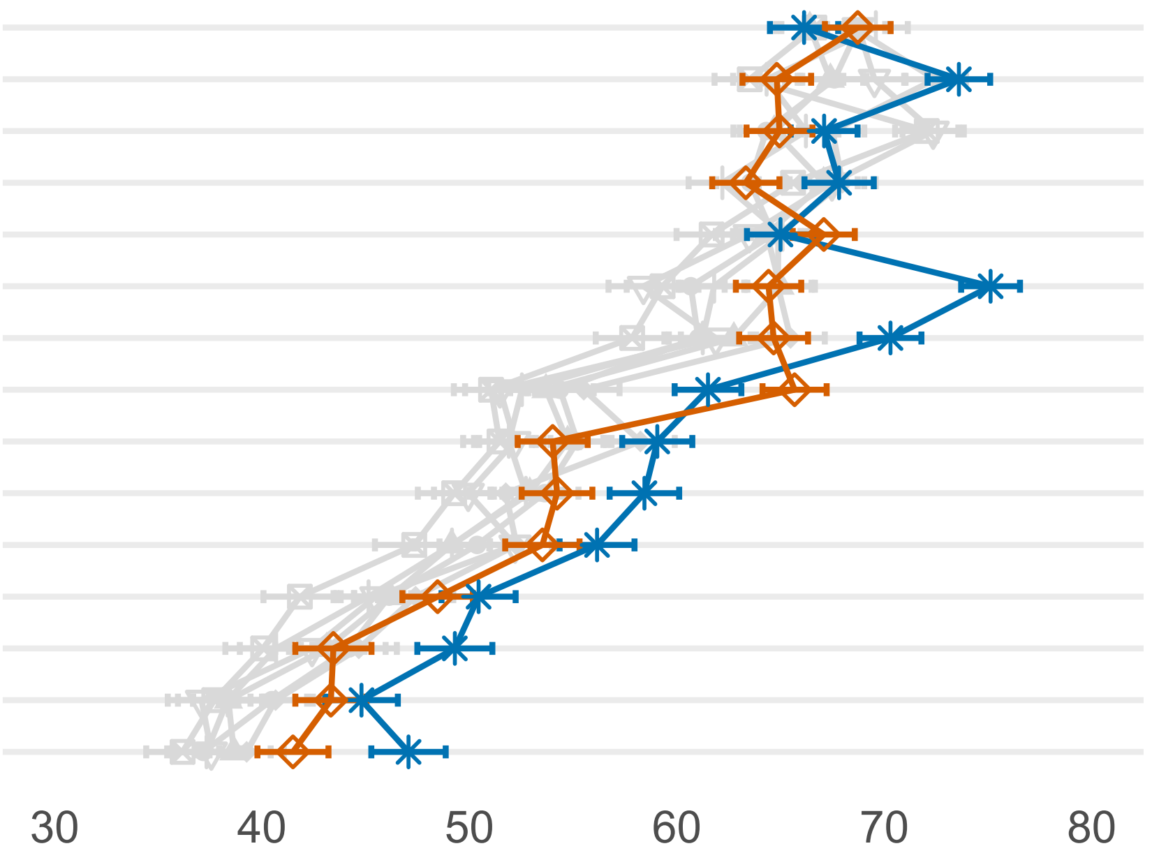
Falsification Tests by Outliers

Slide 27
Life Domain Weights Results
In the three traditional questions, overall, respondents assign similar weights across these questions
Happiness may capture a more emotional motion of well-being than Life Satisfaction and Ladder questions
Notes:
Emotional –
example: less weight on income, more on mental health and emotional health

Slide 28
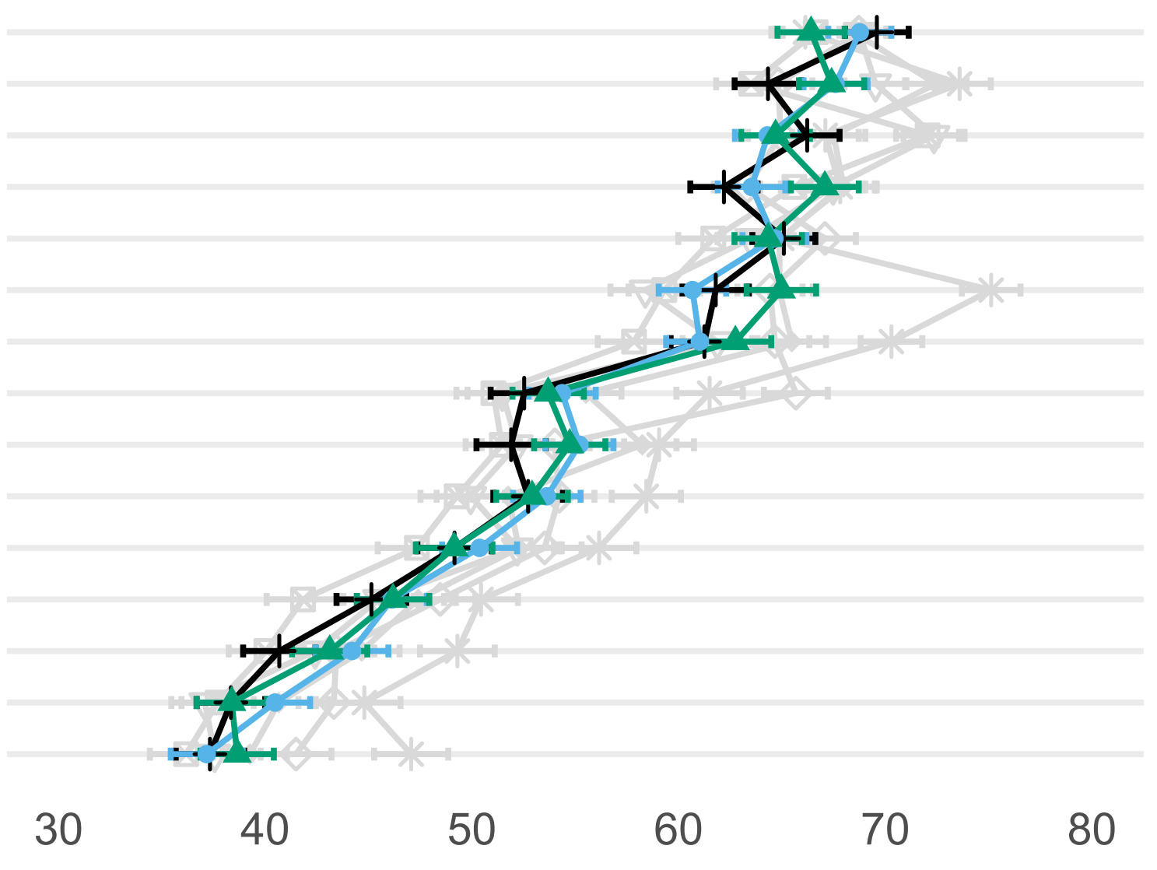
Life Domain Weights Results
Notes:
Emotional –
example: less weight on income, more on mental health and emotional health

Slide 29
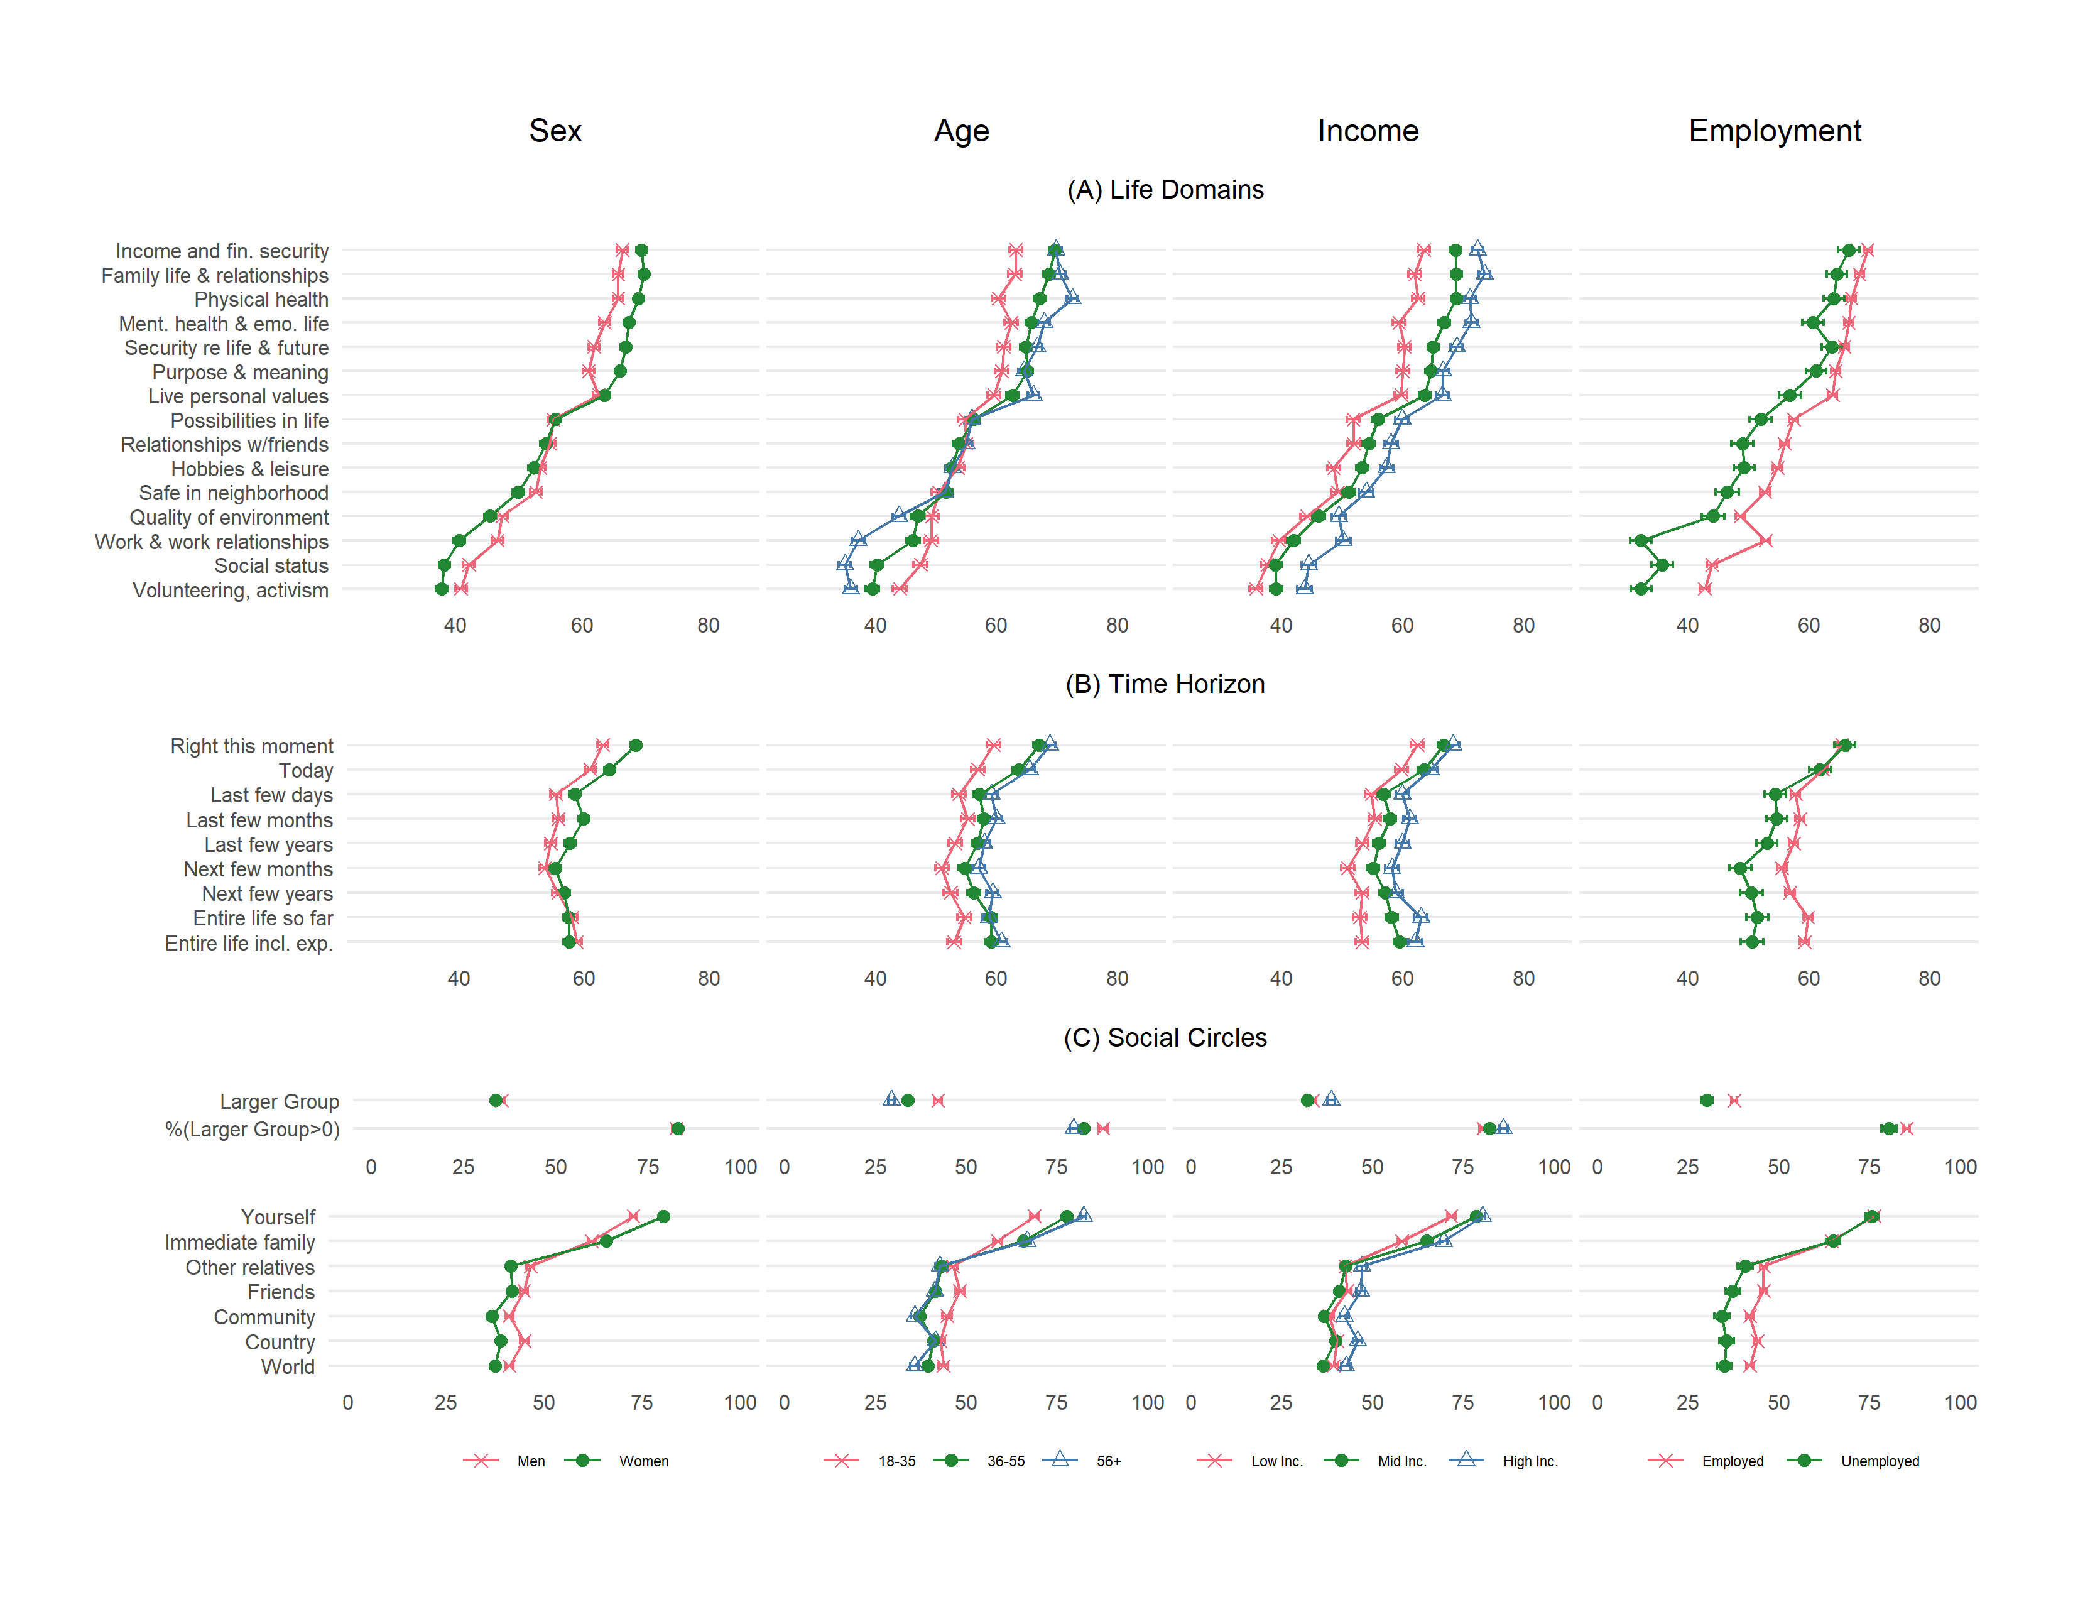
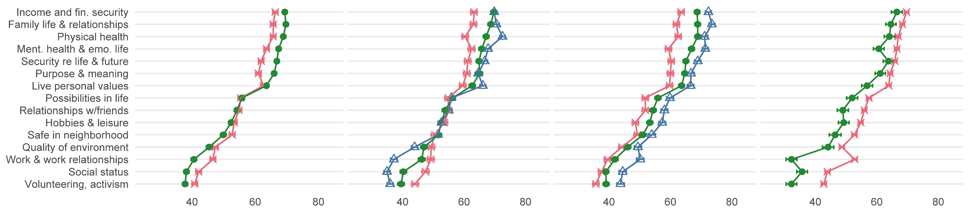
Life Domain Weights by Demographics
General Demographic Results:
Some groups systematically use a wider range of the 0–100 scale than others
The relative ranking of domains is generally maintained across the groups
Notes:
“Physical health” is the most important domain for those above 55
for the rest, “Income and financial security” and “Family life and family relationships” are both more important
Women report significantly less weight on “Work and relationships with co-workers” than on “Quality of the environment,” while men report essentially the same weights on both
“Work and relationships with co-workers” drops in reported weight among unemployed respondents relative to employed ones

Slide 30
Life Domain Weights by Demographics
Age:
“Physical health” is most important for 56+.
“Income and financial security” & “Family life and family relationships” is most important for those under 55
Notes:
“Physical health” is the most important domain for those above 55
for the rest, “Income and financial security” and “Family life and family relationships” are both more important
Women report significantly less weight on “Work and relationships with co-workers” than on “Quality of the environment,” while men report essentially the same weights on both
“Work and relationships with co-workers” drops in reported weight among unemployed respondents relative to employed ones

Slide 31
Life Domain Weights by Demographics
Sex:
Women weigh “Work and relationships with co-workers” less than “Quality of the environment.” Men weigh “Work and relationships with co-workers” equally to “Quality of the environment”
Employment:
Naturally, “Work and relationships with co-workers“ is more important to employed than unemployed
Notes:
“Physical health” is the most important domain for those above 55
for the rest, “Income and financial security” and “Family life and family relationships” are both more important
Women report significantly less weight on “Work and relationships with co-workers” than on “Quality of the environment,” while men report essentially the same weights on both
“Work and relationships with co-workers” drops in reported weight among unemployed respondents relative to employed ones

Slide 32
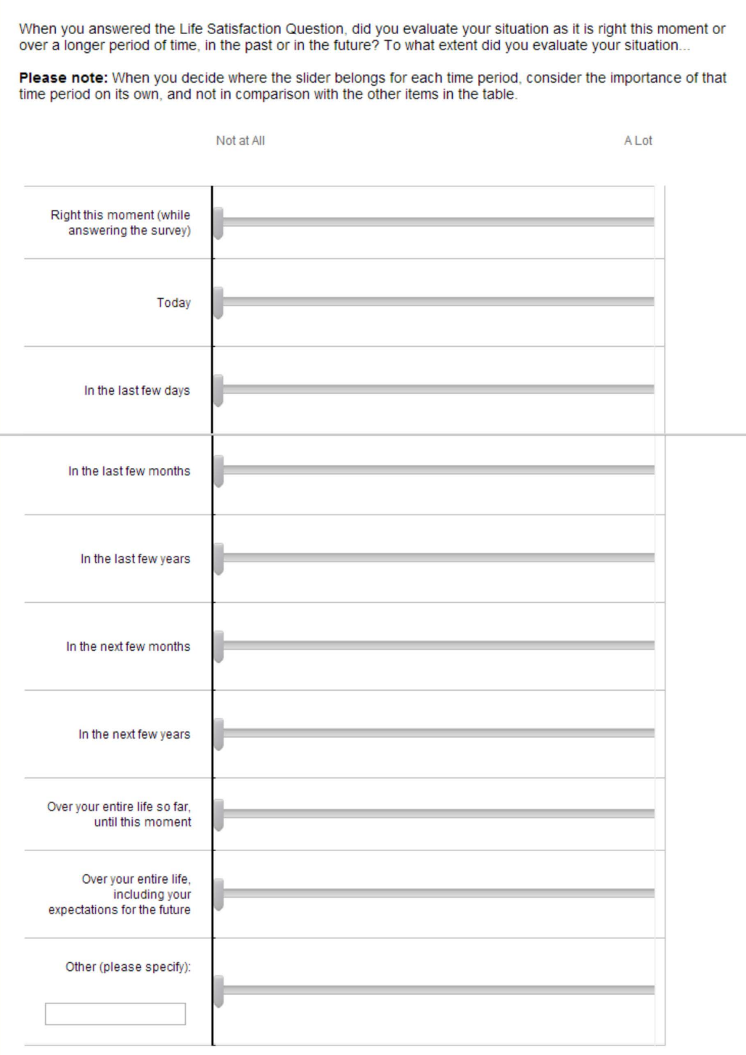
Time Horizons Introspection Question

Slide 33
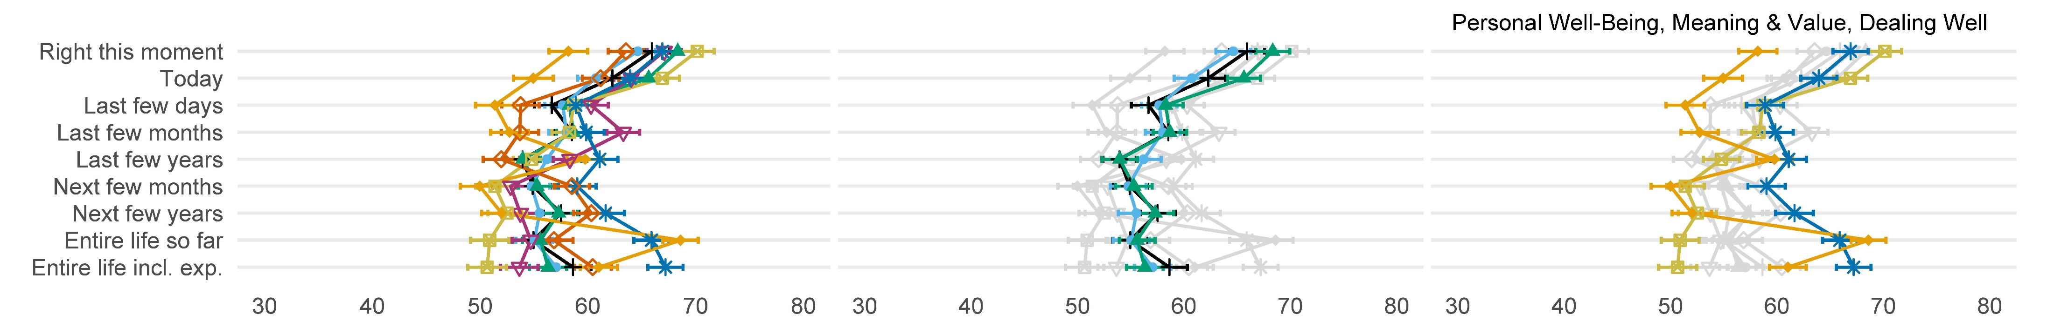
Time Horizon Weights Results
SWB questions appear not to have time profiles that cleanly capture any of the common temporal-utility notions
Respondents put positive weights on all periods, ranging from 50-70, which does not fit to flow or forward-looking utility
Putting significantly more weight on a few minutes in the present than the rest of the day or one’s life does not correspond to lifetime utility either

Slide 34
Time Horizon Weights Results
Respondents react to the wording of the questions, suggesting that wording changes may be effective at directing respondents toward a desired timeframe
Wording influence is seen in the Dealing Well question, which explicitly asks about the past and received the lowest weight for the present and the highest for “life so far”
Personal Well-Being question is the most flow-like
(highest weights for the present, lowest for “entire life” and including the future)
The Meaning & Value question has a unique, unexpected pattern

Slide 35
Time Horizon Weights Results

Slide 36
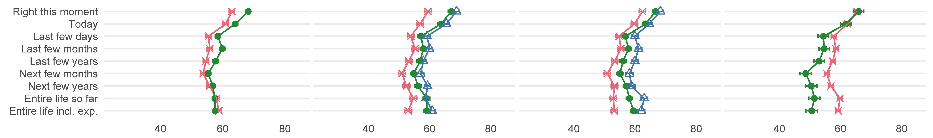
Time Horizon Weights by Demographics
Sex and Employment:
Men and the employed show a somewhat less flow-like profile than women and the unemployed, by putting more weight on their entire life so relative to the present

Slide 37
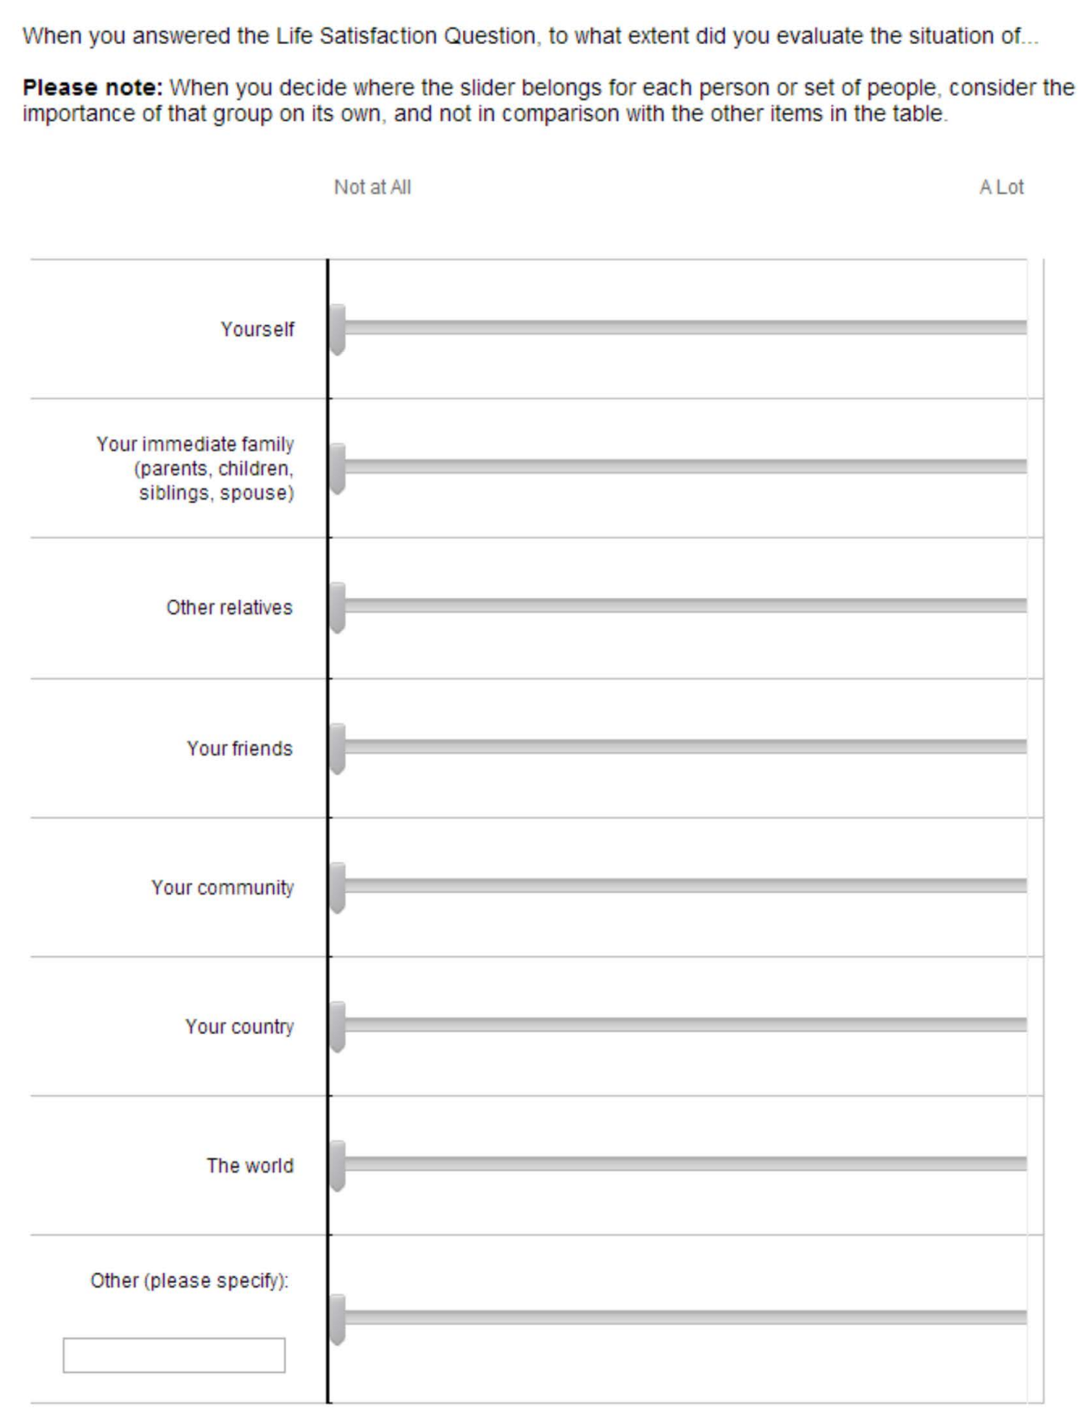
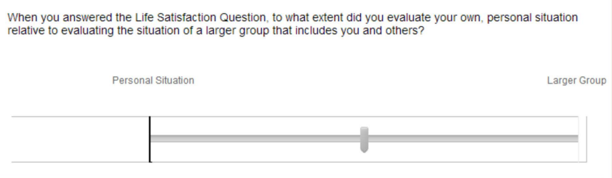
Social Circle Introspection
Two slider interfaces:
“Personal situation” to “larger group”
  If the participant puts all the weight on ”Personal Situation,” the next set of sliders does not appear.
Fixed groups, as in the previous questions

Slide 38
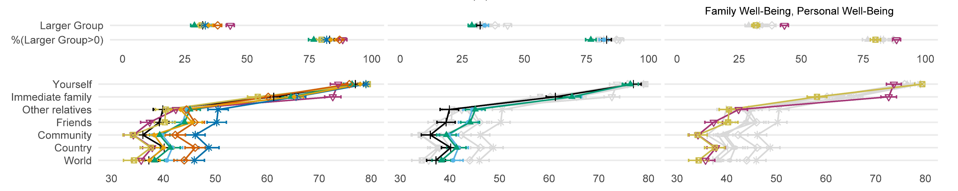
Social Circle Weights Results
The average weights range from 35-80 (wider than previous domains)
On average, respondents allocate at least some non-zero weight to “Larger Group” but less than “Personal Situation” weights.
There is no evidence of a completely self-centered notion. All eight questions contain a significant family component
Notes:
Yourself” was allocated the most weight—always above 70—with “Immediate Family” an unambiguous second—always above 60 (with the single exception of Personal Well-Being discussed below).
All other social categories were allocated less weight, with relatively little variation across them

Slide 39
Social Circle Weights Results
Respondents react sensibly to SWB question wording, such as in the Family Well-Being and Personal Well-Being questions
In Meaning & Value, and to a lesser extent for Options & Possibilities, respondents assign higher weights to individuals outside the immediate family, matching the other-regarding components of preferences
Notes:
Yourself” was allocated the most weight—always above 70—with “Immediate Family” an unambiguous second—always above 60 (with the single exception of Personal Well-Being discussed below).
All other social categories were allocated less weight, with relatively little variation across them

Slide 40
Social Circle Weights Results
Notes:
Yourself” was allocated the most weight—always above 70—with “Immediate Family” an unambiguous second—always above 60 (with the single exception of Personal Well-Being discussed below).
All other social categories were allocated less weight, with relatively little variation across them

Slide 41
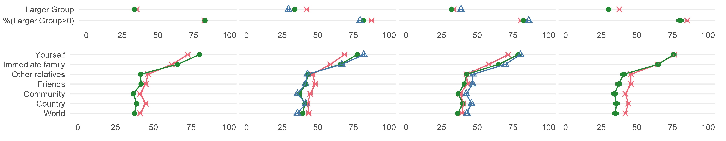
Social Circle Weights by Demographics
Women, older, and unemployed respondents are higher or equal on themselves and immediate family and lower on wider social circles relative to men, younger, and employed respondents
However, for the sex and age comparisons, these differences might reflect cross-group differences in scale-use

Slide 42
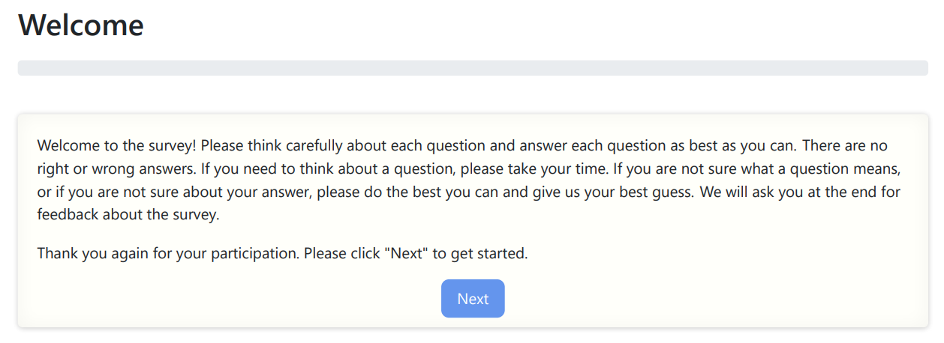
Second Survey - General information
The survey was conducted from September 24 to October 7, 2022
Respondents were recruited through “Prolific”
N = 1,497 respondents completed the survey
The median time to complete the survey: 19 minutes

Slide 43
Survey Design Differences (2nd vs 1st survey)
Larger sample per question, more representative of the US population
Only 5 out of 8 SWB questions
Each participant was asked all 5 SWB questions, and after each of these, they were asked 2 introspective questions (instead of 3)
Introspective questions:
  Elaborate and extensive instructions
  New interface (instead of the sliders)
  Weights were determined by allocating a fixed budget between domains
  A smaller set of sub-domains for each introspective component

Slide 44
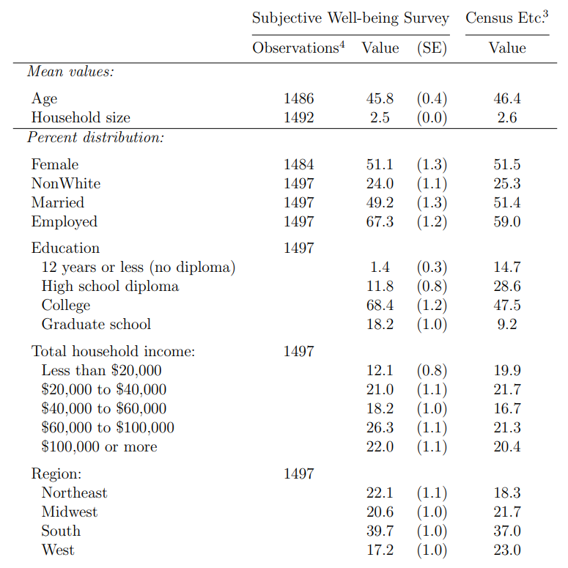
Respondents
Recruited to try to match the U.S. population:
Respondents roughly match the population on sex, marital status, household size, and the fraction that is White
However, they are older, more educated, higher income, and more Northeast and less West

Slide 45
SWB Questions
Questions from the first survey:
Happiness
Life Satisfaction
Personal Well-Being
Family
Well-Being
Standard SWB questions
Appeared promising and at the same time provide a clean test of social-circle wording variation
New SWB question:
Happiness
Yesterday
Overall, how happy did you feel yesterday?
Please give a number between 0 (extremely unhappy)
and 10 (extremely happy)
This question was added to test the effects of wording on time horizon interpretation

Slide 46
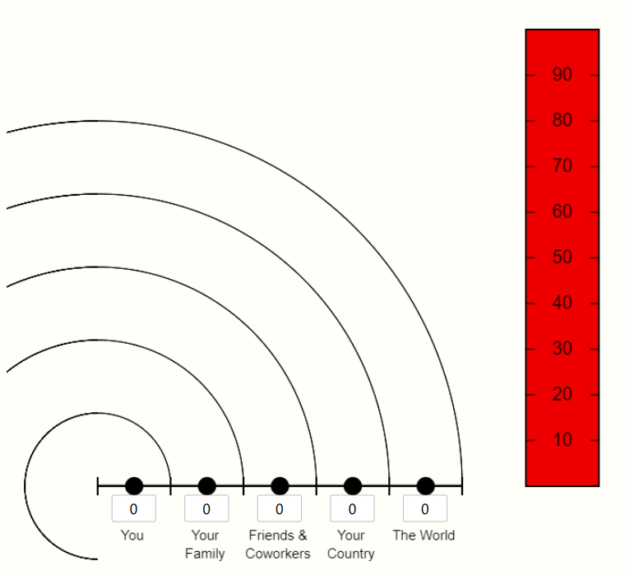
Introspective Questions
Example of the interface for social circles:
After each SWB question, participants were asked two introspective questions: time horizon and social circles
Participants were asked to distribute 100 points between the different categories, illustrated by matching animation
These questions were more detailed and helped focus on the wanted interpretations
In this alternative design, weight magnitudes are easier to interpret
Notes:
Wanted interpretations:
You should report how you interpreted the question when answering it and not how you think, after the fact, you should have interpreted it.
We are only interested in what you interpreted the question as asking about and not what comparisons you made.
We are only interested in what you interpreted the question as asking about and not what else may have affected your answer.

Slide 47
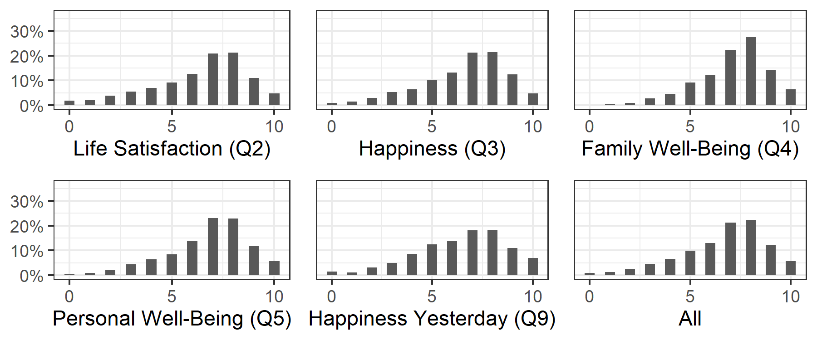
Response Histograms, by SWB Question

Slide 48
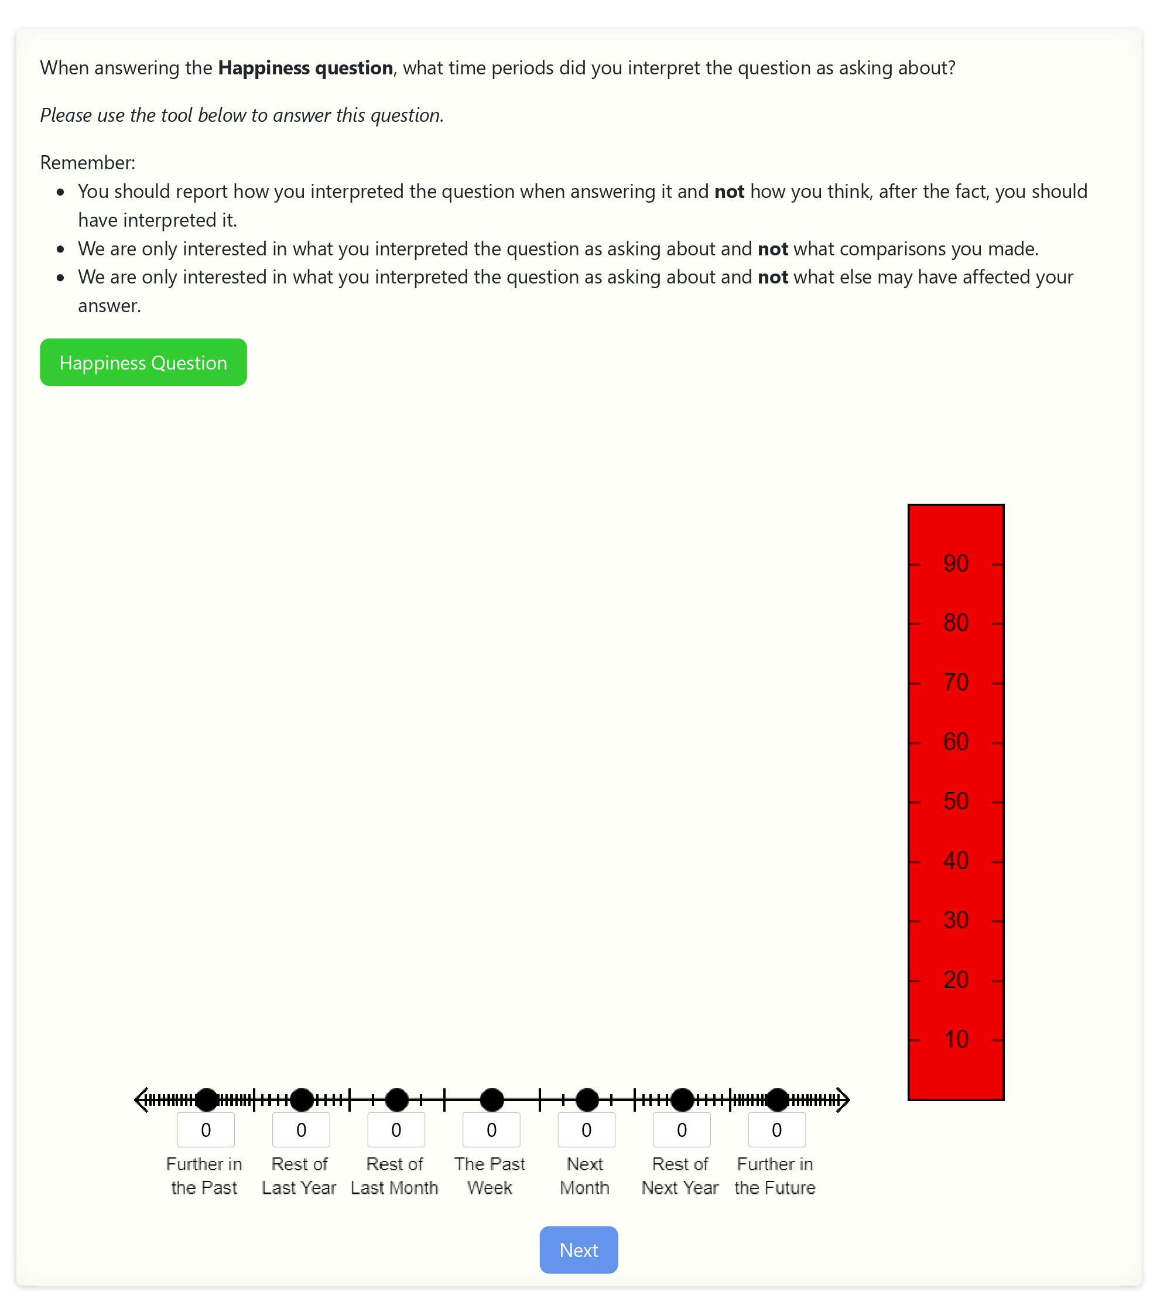
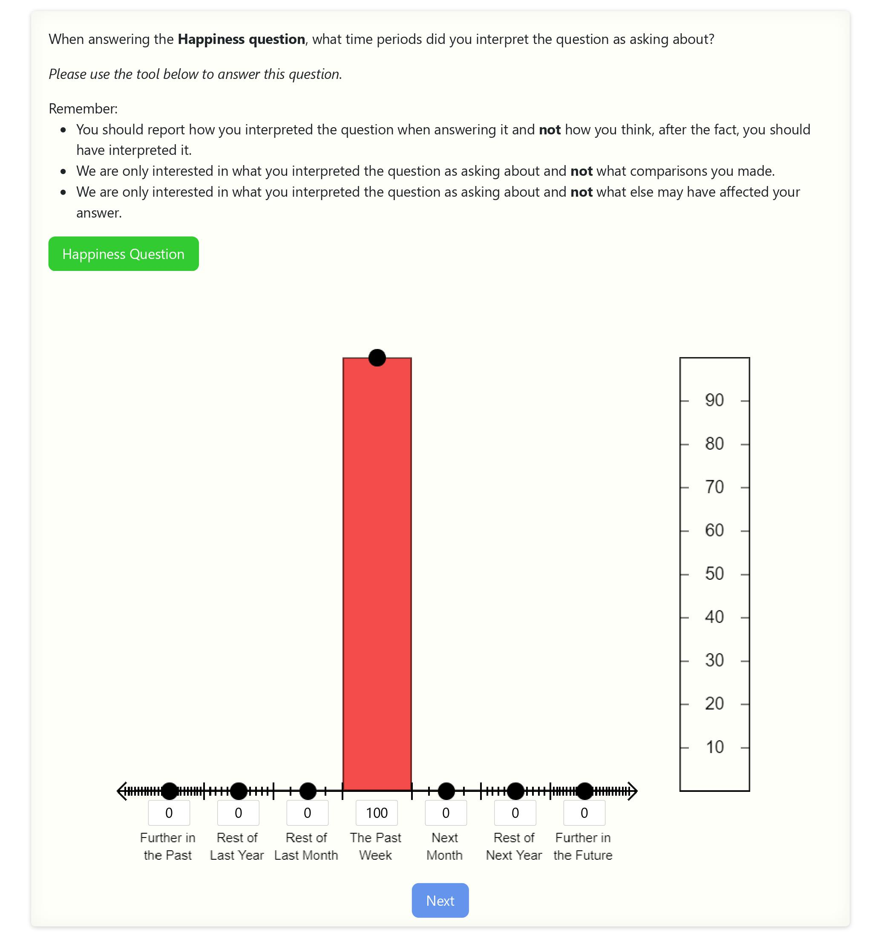
Time Horizons Introspection Question

Slide 49
Time Horizons Introspection Question

Slide 50
Time Horizons Introspection Question
Interface before allocation:
Example of the interface after allocation:

Slide 51
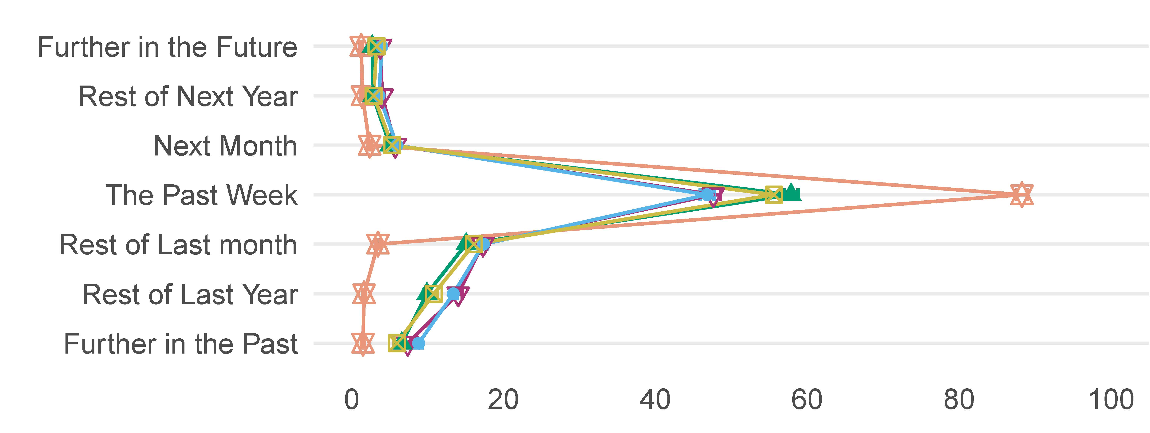
Time Horizon Weight Results
Happiness Yesterday appears consistent with a relatively clean flow-utility interpretation (much of the weight is on the past week)
The other questions suggest a mix of mostly flow and backward-looking utility, while Happiness and Personal Well-Being appear more flow-like than Life Satisfaction and Family Well-Being, as in the first survey
Notes:
Main conclusions stay the same, while survey designs do make a difference (new question)

Slide 52
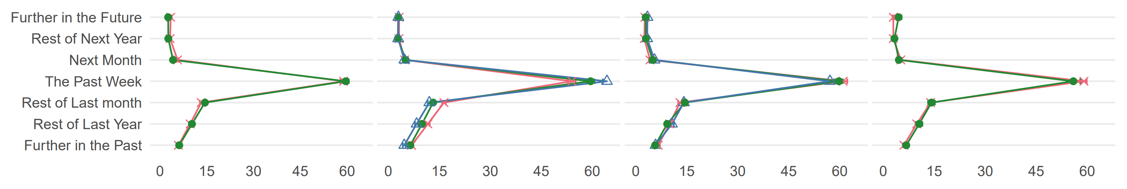
Time Horizons Weights by Demographics
The way sociodemographic groups interpret SWB questions changed from the first survey
When focusing on the time-explicit Happiness Yesterday (not shown in figures), we find much fewer time-horizon differences, suggesting that making SWB questions less ambiguous could move them closer to the desired utility notions on average and reduce their interpretation variance across groups

Slide 53
Time Horizons Weights by Demographics
Age:
young respondents were more flow-like than the older ones
Income:
low-income respondents were more flow-like than high-income ones

Slide 54
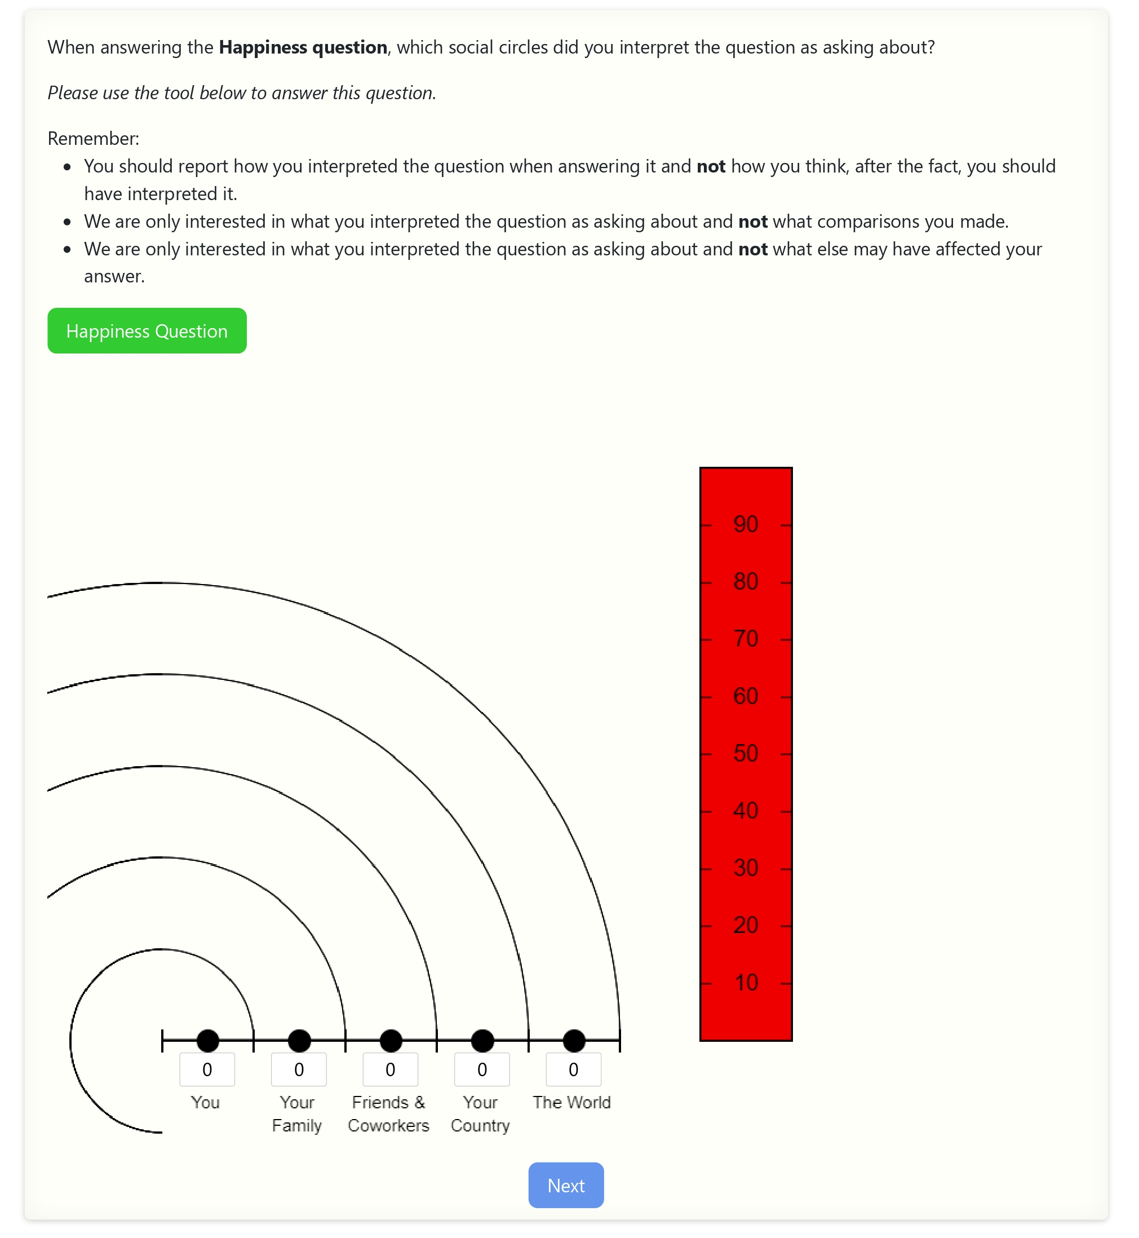
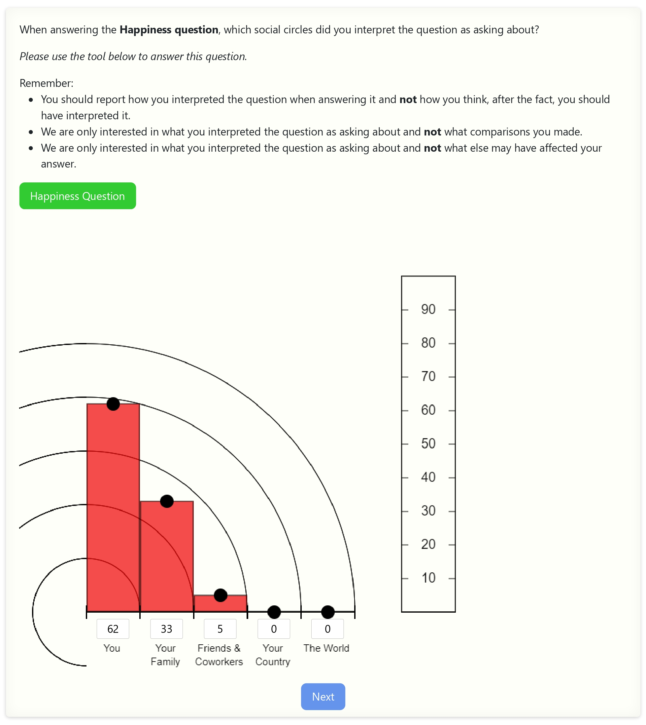
Social Circle Introspection Question

Slide 55
Social Circle Introspection Question

Slide 56
Social Circle Introspection Question
Interface before allocation:
Example of the interface after allocation:

Slide 57
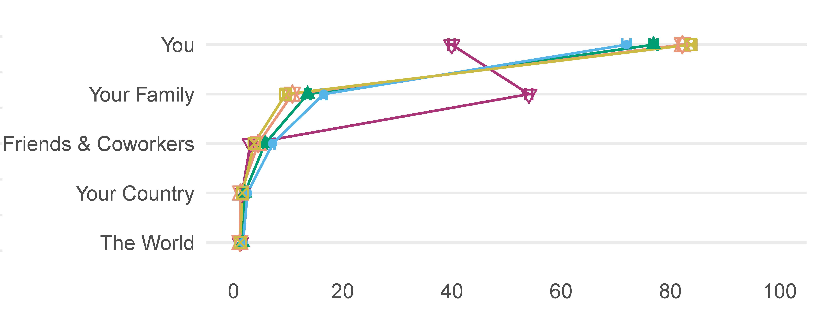
Social Circles Weights Results
Almost no weight on circles larger than friends, as opposed to the first survey
A unique yet expected pattern for Family Well-Being question
Happiness and Life Satisfaction have a significant family component,
while Personal well-being and Happiness Yesterday are more self-centered
Tight standard error bars suggest the questions have distinguishable patterns in time horizons and social circles

Slide 58
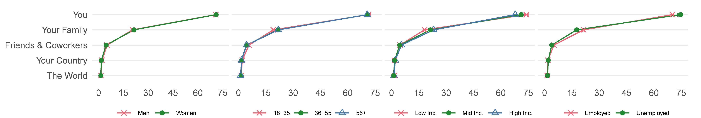
Social Circles Weights By Demographics

Slide 59
Social Circles Weights By Demographics
Income:
low-income respondents are more self-centered
Employment:
unemployed are more self-centered than the employed

Slide 60
Conclusion
Two introspective surveys were conducted and analyzed to evaluate whether responses to SWB questions correspond with any of the utility notions researchers assume they represent
The conclusions are both negative and positive.
We indicate the problems that arise when using SWB measures and the caution that should be taken but also find applicable guidelines to correct these issues

Slide 61
Conclusion
Almost none of the SWB measures correspond to a standardly assumed time horizon: flow, forward-looking, or lifetime utility.
The Happiness Yesterday question is a promising exception (most flow-like)
Regarding social circles, none of the SWB measures cleanly match a self-centered utility notion. Specifically, all incorporate concern for others, particularly one’s family. Yet, respondents react in the expected direction to variations in question wording (such as personal well-being)
Heterogeneity exists across sociodemographic groups in interpreting SWB questions (important when aggregating data for welfare measures and policy). This finding also changes with question wording

Slide 62
Applicable Practical Advice
To users of existing SWB data:
Do not automatically interpret SWB data as measures of the standard utility notions
To researchers who add their own SWB question to an ongoing survey:
Change the standard wording to bring answers more in line with the utility notion assumed
  Flow utility:
  Happiness yesterday
  Self-centered:
  Personal Well-Being
To researchers who are designing their survey:
It may be helpful to include introspective questions like those in our surveys

Slide 63
Further Reading and Research
For the full paper and appendix, please visit the website:
LINK
The data we collected (presented here + some that were not analyzed) and the survey codes are also available on the journal website for further use and research

Slide 64
Thank You
For financial support, we are grateful to the Samuel Curtis Johnson Graduate School of Management at Cornell University, the Woodrow Wilson School at Princeton University, the National Science Foundation Graduate Research Fellowship Program grant no. DGE-1144153, and NIH/NIA grants R01-AG065364 to Hebrew University, R01-AG040787 to the University of Michigan, R01-AG051903 to UCLA, and P30-AG024928 to Princeton University.

Slide 65
SWB questions - Full Wording (1)
Ladder:
  Please imagine a ladder with steps numbered from 0 at the bottom to 10 at the top.
  The top of the ladder represents the best possible life for you, and the bottom of the ladder represents the worst possible life for you.
  On which step of the ladder would you say you personally feel you stand at this time?
  Please give a number from 0 to 10: _____
Life Satisfaction:
  All things considered, how satisfied are you with your life as a whole these days?
  Please give a number between 0 (extremely dissatisfied) and 10 (extremely satisfied): _____
Happiness:
  Taking all things together, how happy would you say you are? Please give a number between 0 (extremely unhappy) and 10 (extremely happy): _____
Click to go back to slides

Slide 66
SWB questions - Full Wording (2)
Family Well-Being:
  On a scale from 0 to 10, how would you rate the overall well-being of you and your family? Please give a number between 0 (lowest rating) and 10 (highest rating): _____
Personal Well-Being:
  On a scale from 0 to 10, how would you rate your overall personal well-being? Please give a number between 0 (lowest rating) and 10 (highest rating): _____
Dealing Well:
  People’s situation in life depends on both the circumstances they have been given and how they deal with these circumstances. To what extent do you feel that you have dealt well so far with the circumstances you have been given in life? Please give a number between 0 (“I have dealt extremely poorly with the circumstances I have been given”) and 10 (“I have dealt extremely well with the circumstances I have been given”): _____
Click to go back to slides

Slide 67
SWB questions - Full Wording (3)
Options & Possibilities:
  On a scale from 0 to 10, to what extent do you feel that your life is full of options and possibilities that you are free to choose from? Please give a number between 0 (extremely limited options to choose from) and 10 (very many options to choose from): _____
Meaning & Value:
  On a scale from 0 to 10, to what extent do you feel that your life is meaningful and has value? Please give a number between 0 (not meaningful and has no value) and 10 (extremely meaningful and has lots of value): _____
Click to go back to slides

Slide 68
Respondents
Notes:
Not in the 4 dimensions:
more educated and more Northeast and less South, more White, with somewhat larger households, and with higher participation in the labor force.

